Slide 1
Managing invasives in Belgium - (not) nearly there (yet) -
LIFE U-SAVEREDS symposium
12-13 April 2018
Perufia
Notes:
You’ll find an array of invasives in this talk, colourful as a margarita pizza

Slide 2
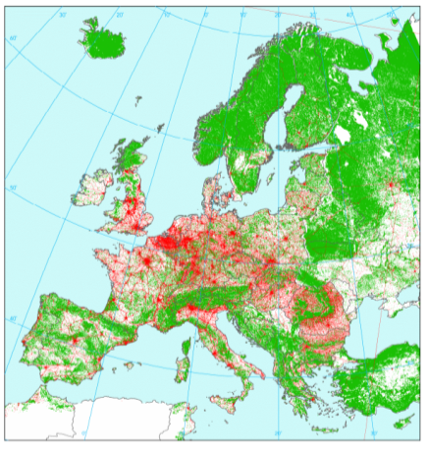
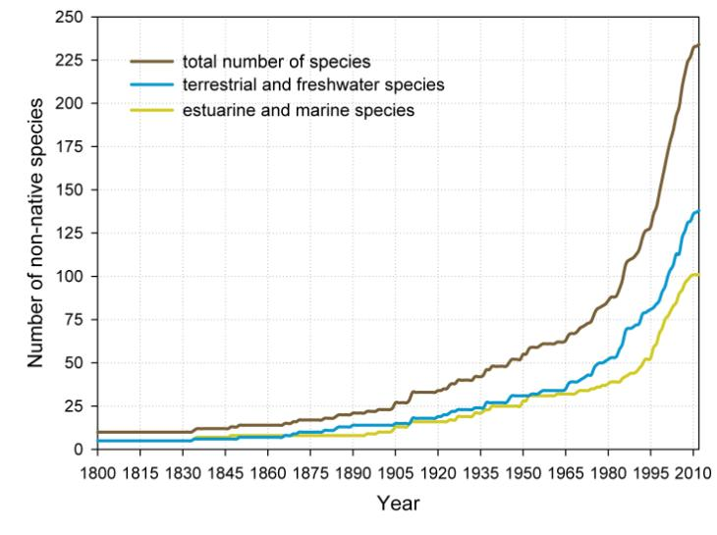
Flanders = urban sprawl
Near “absence” of spatial planning
26 % built-up land
High pressures on open space
525 inhabnts/km²
Logistical hub
Natural areas small and vulnerable
EEA 2002

Slide 3
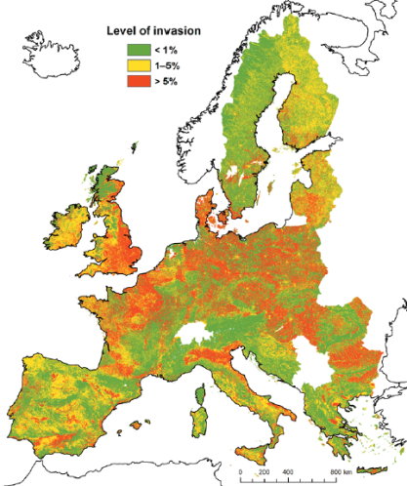
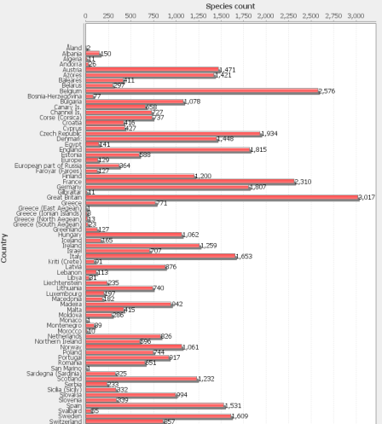
Chytrý et al. 2009 Div Dist, DAISIE
Notes:
In terms of employment for invasion biologists, Flanders is one of the top regions in the world. In fact, the whole region around the north sea is a global invasion hotspot.

Slide 4
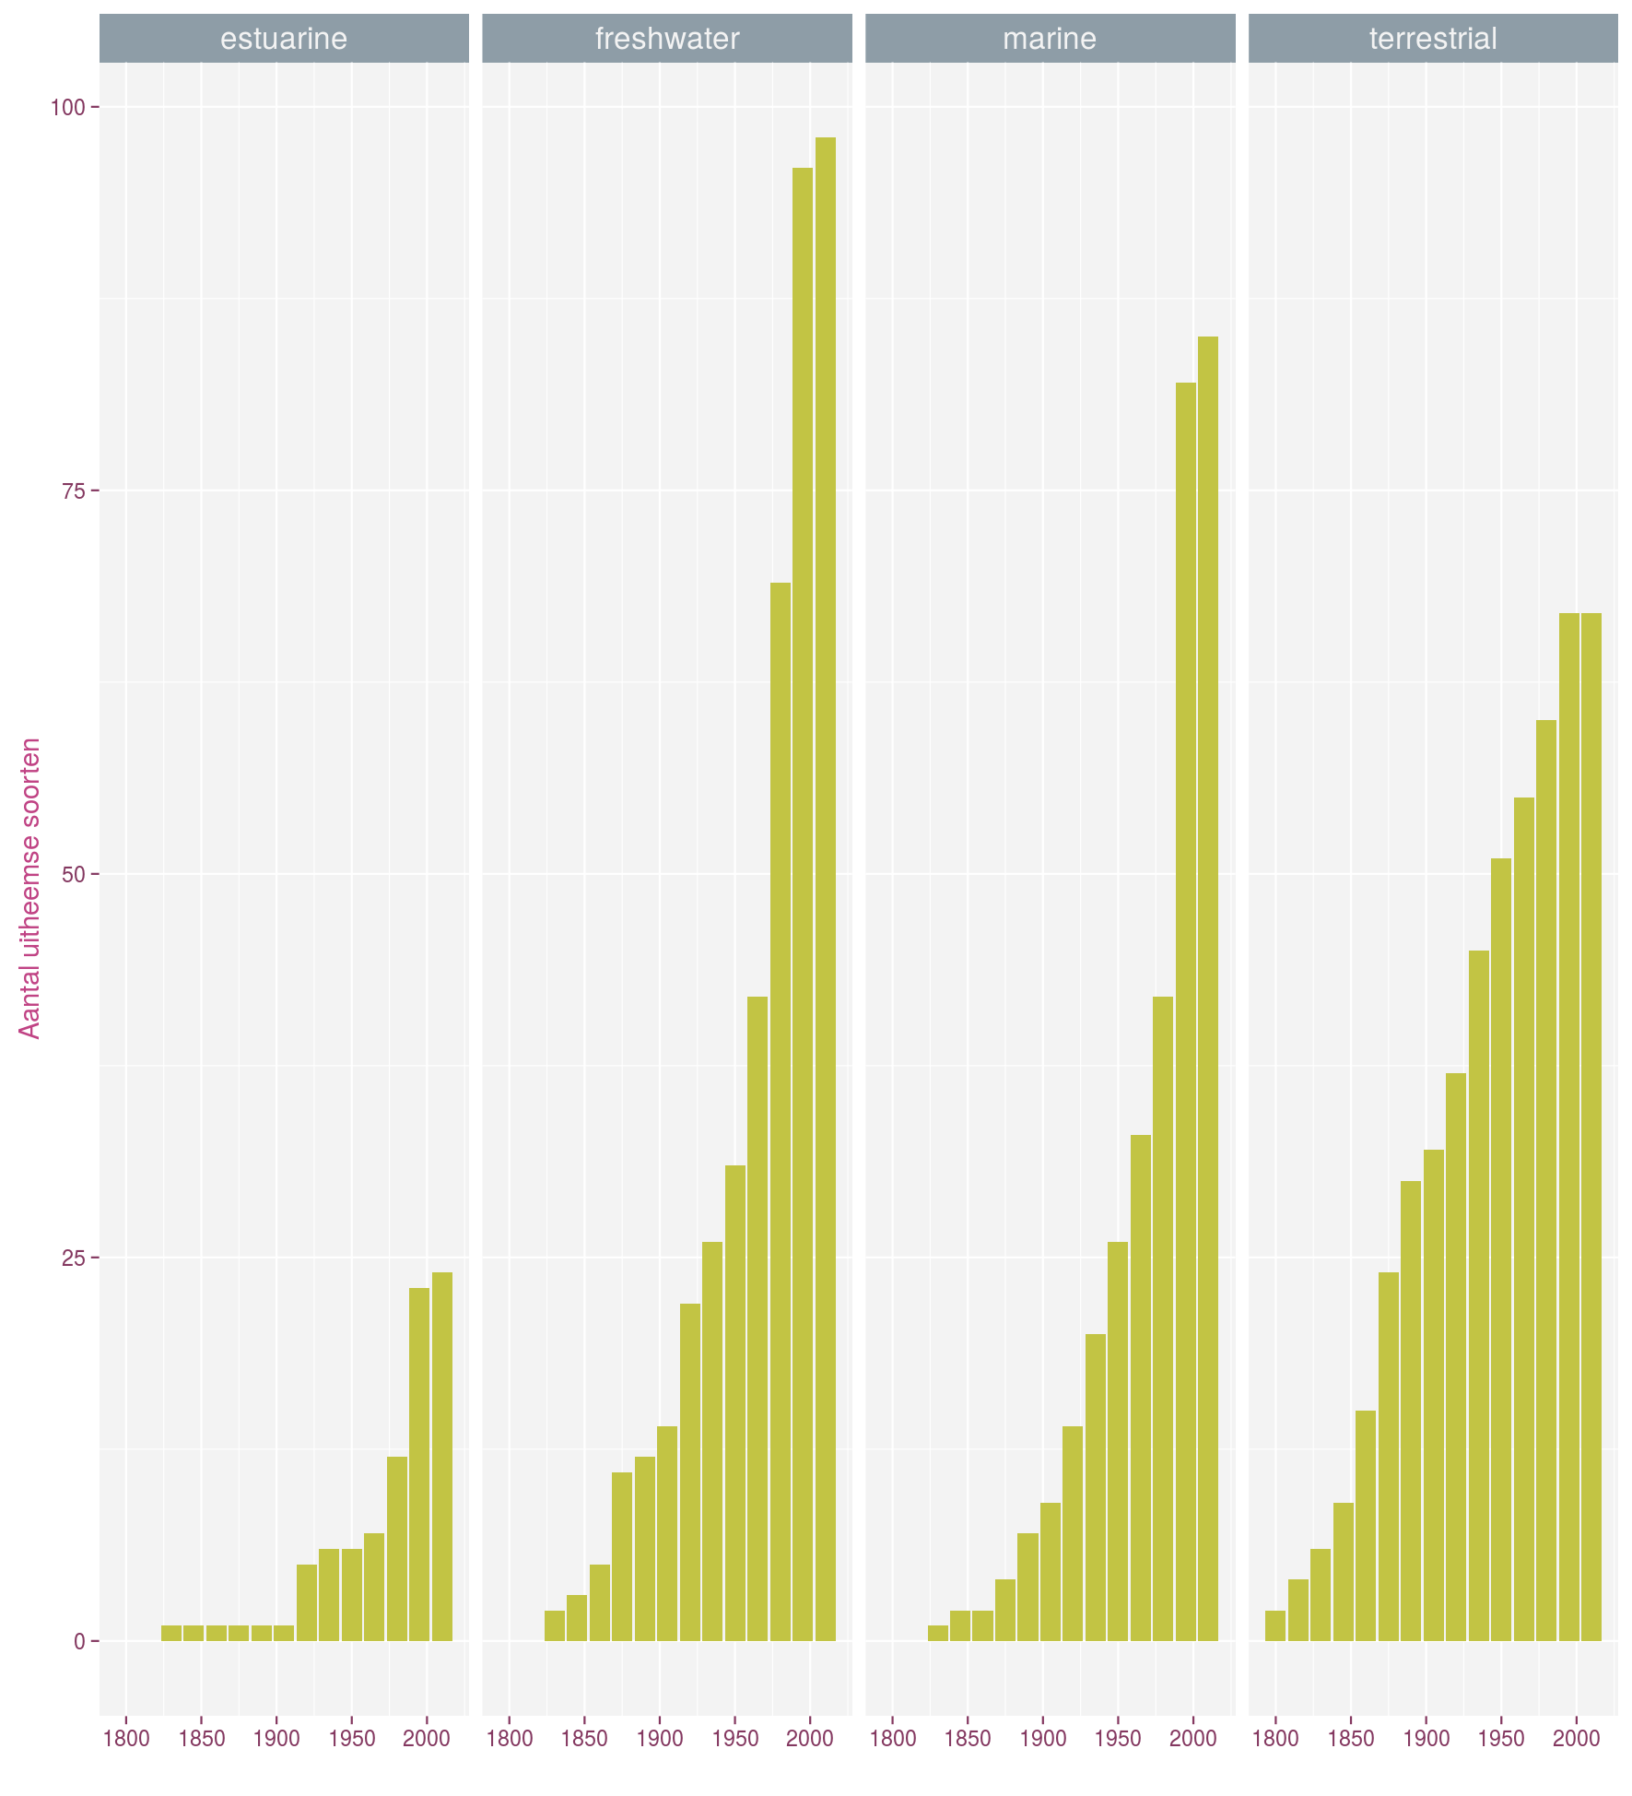
Trends in non-natives
Rate ++
Number ++
INBO, Biodiversity indicators 2017

Slide 5
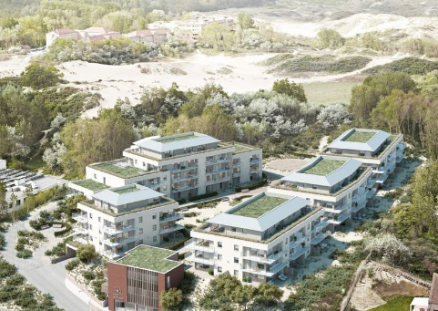
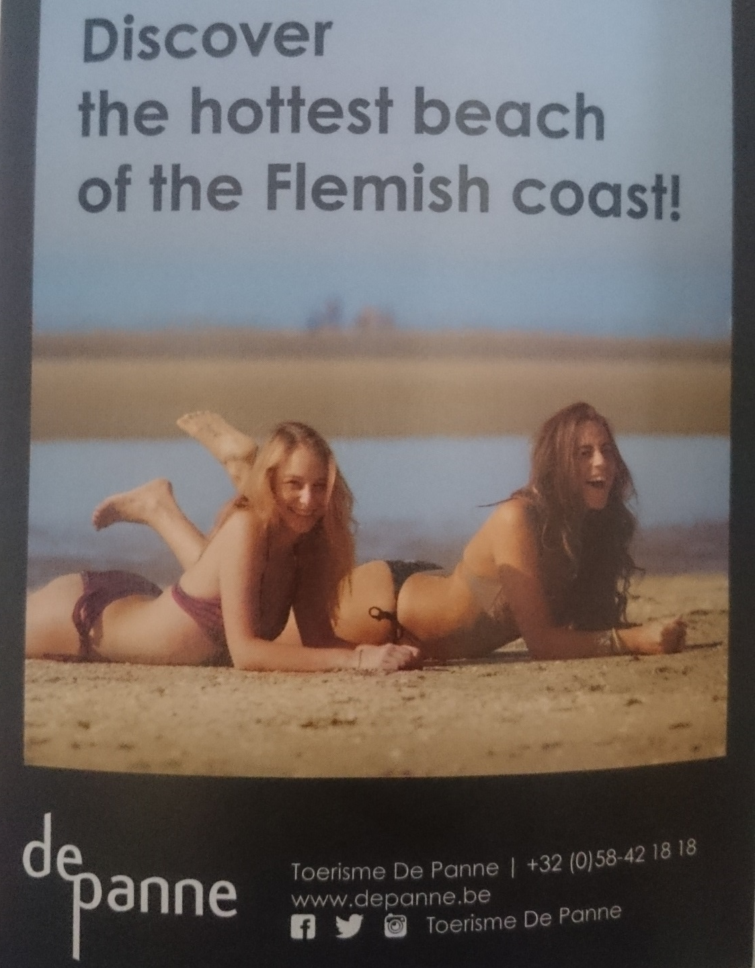
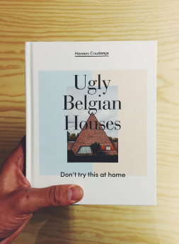
Notes:
This is how our ugly 73 km coastline is advertised in in-flight magazines, but I rather tend to go there for some of our most pristine ecosystems with fully functional landscape ecological processes like shifting sands…

Slide 6
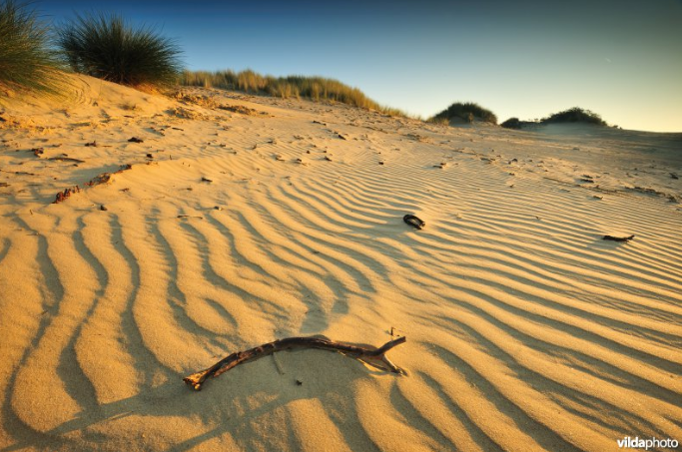

Slide 7
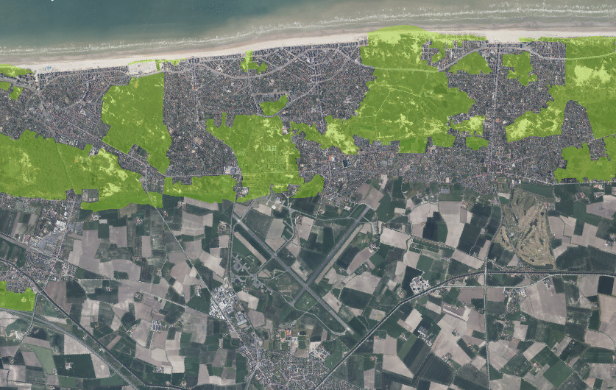
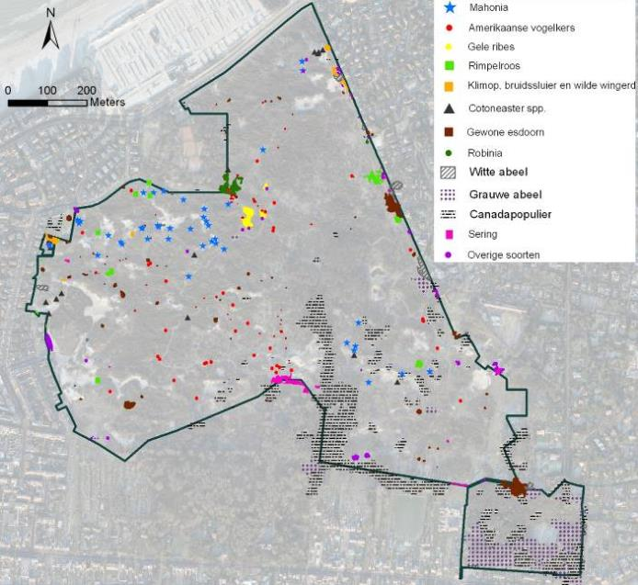
Highly fragmented landscape

Slide 8
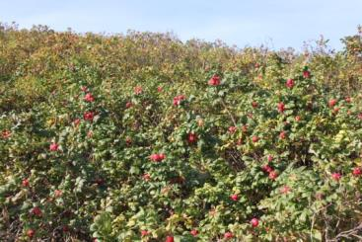
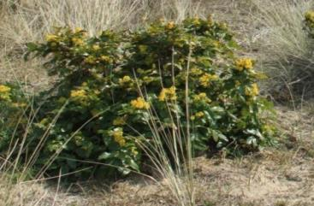
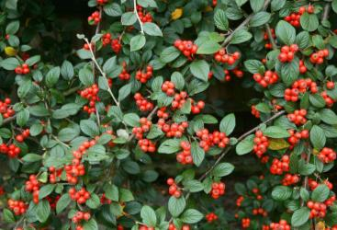
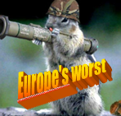
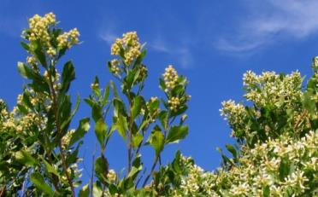
Notes:
In terms of their area of occupancy in te dunes, the most important ones are…

Slide 9
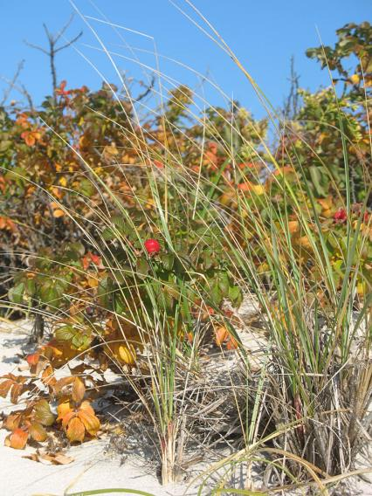
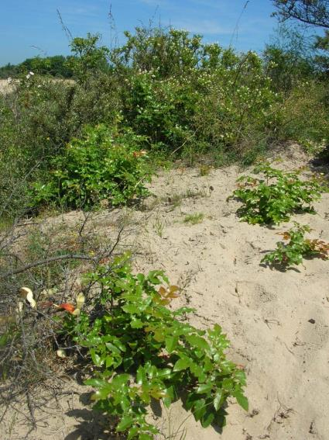
Ecosystem integrity
Rosa rugosa
Berberis aquifolium
Provoost et al. PINK
Notes:
Gem opp natuurreservaat vlaanderen: 35 ha

Slide 10
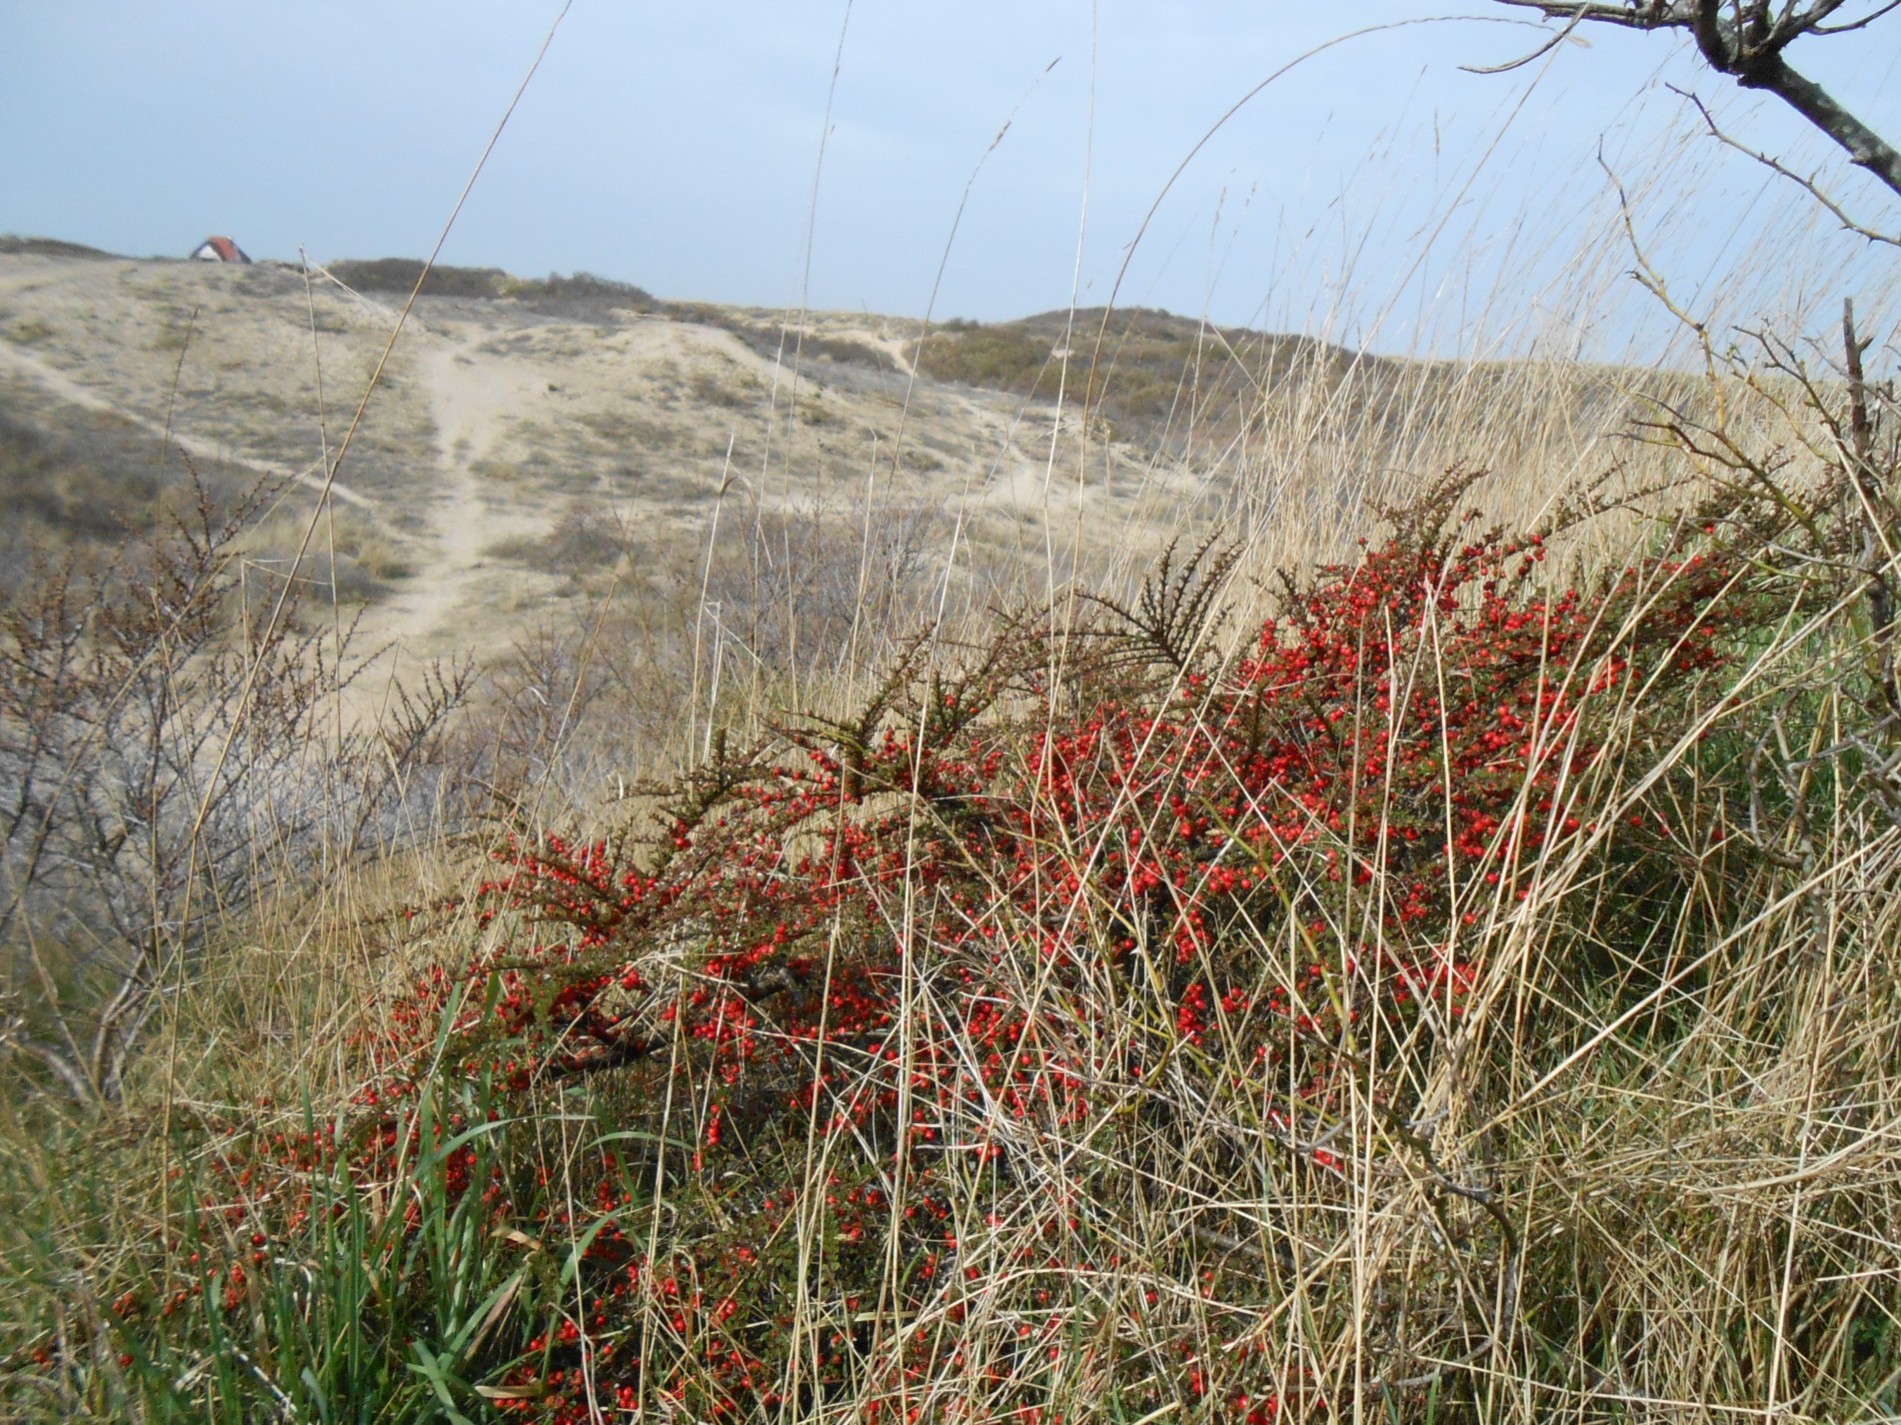

Slide 11
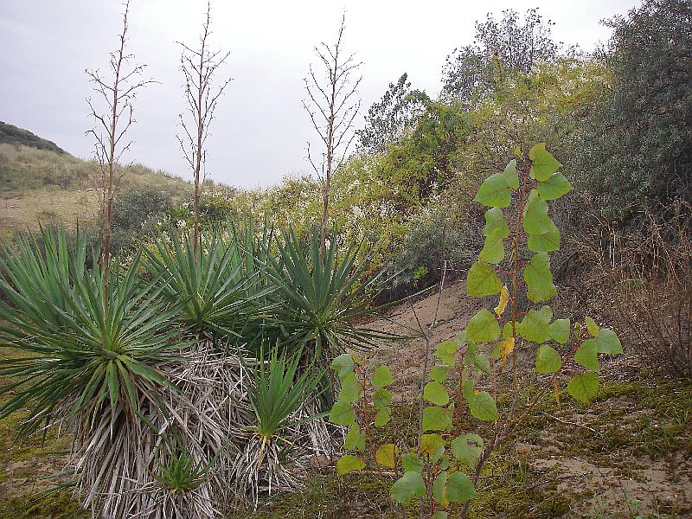
Notes:
But at places looks like a new mexican desert ecosystem

Slide 12
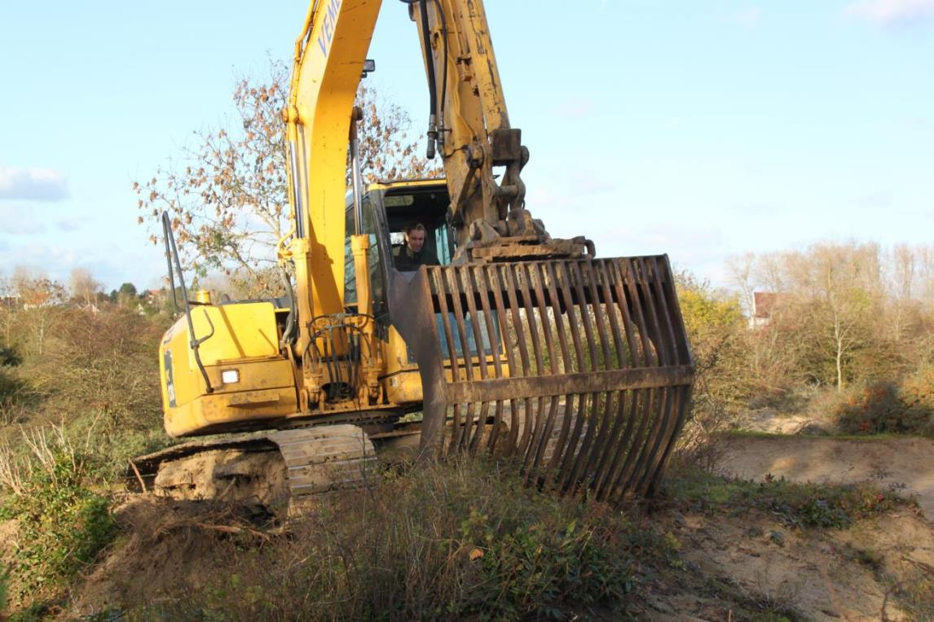
Huge management costs

Slide 13
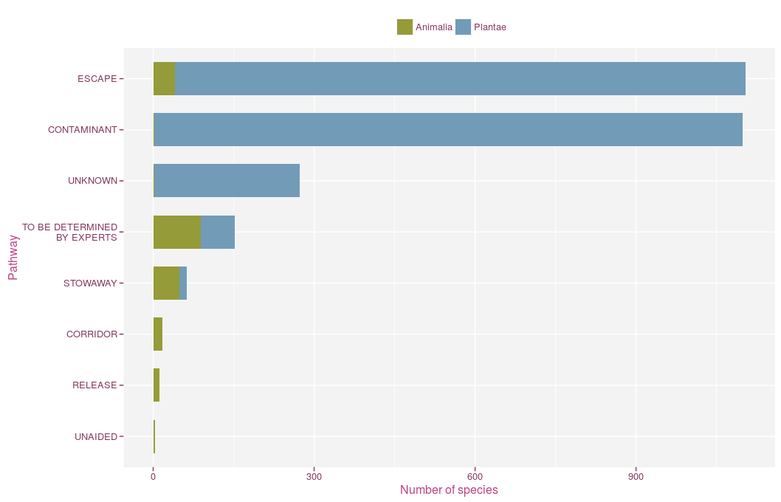
Introduction pathways
Notes:
Come in through a number of pathways, on this graph you can see that we have far better intel on pathways of introduction for plants, but from what we know, the exotic animal section is coming in as stowaways on other goods or commodities, on its own (spontaneous dispersal from other places in the non-native range) and a great deal are escapes from zoos, aquaria etc.

Slide 14
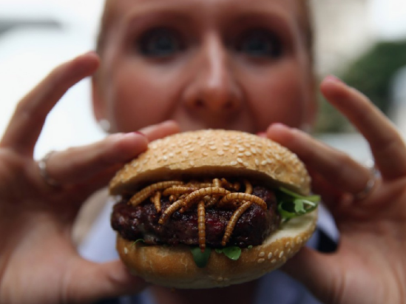
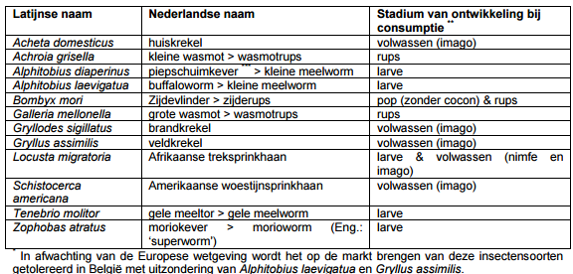
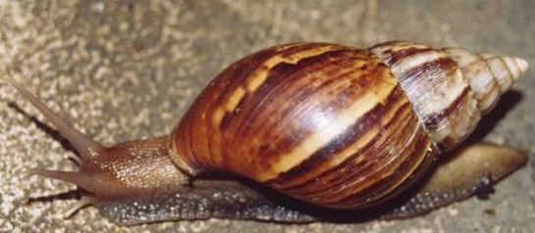

Entomophagy
New pathway
Globally >2000 spp.
No specific regulations in Belgium/Europe
Risk assessments solely focused on food safety, not biodiversity
FAVV 2014
Notes:
Giant african snail achatina fulica – One particularly catastrophic attempt to biologically control this species occurred on South Pacific Islands. Colonies of A. fulica were introduced as a food reserve for the American military during World War II and they escaped. A carnivorous species (Florida rosy wolfsnail, Euglandina rosea) was later introduced by the United States government, in an attempt to control A. fulica but the rosy wolf snail instead heavily preyed upon the native Partula, causing the extinction of most Partula species within a decade.

Slide 15
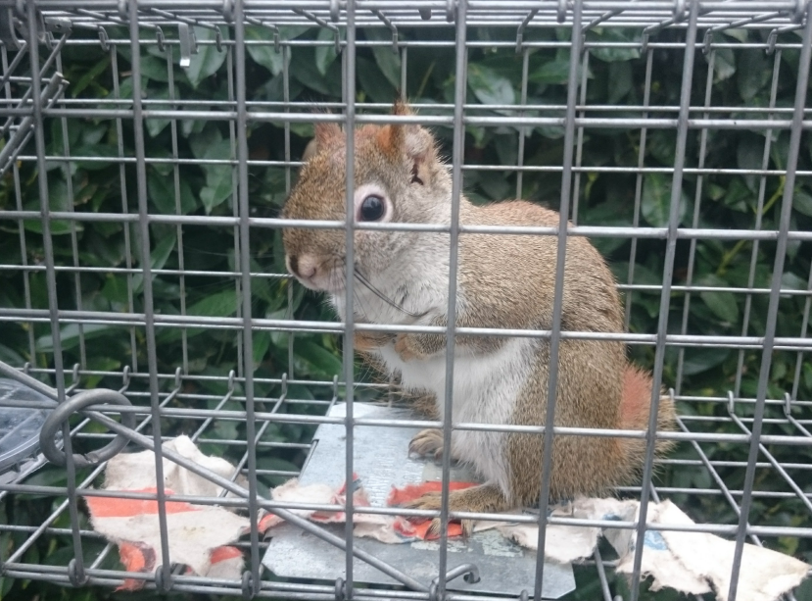
Tamiasciurus hudsonicus, Balen, 2017

Slide 16
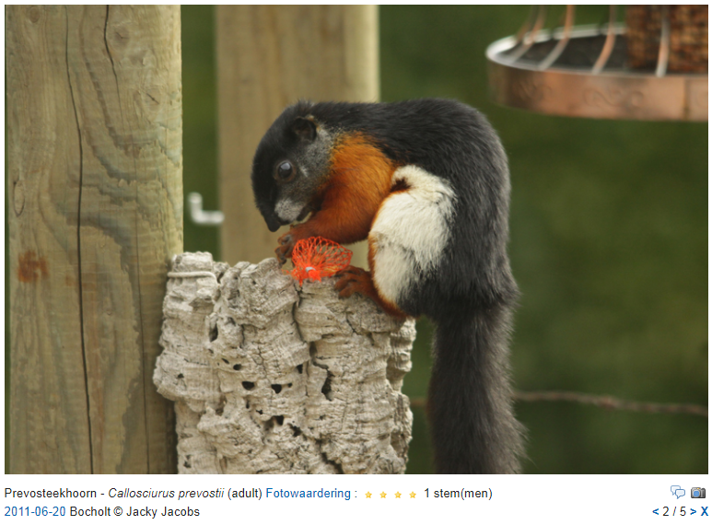
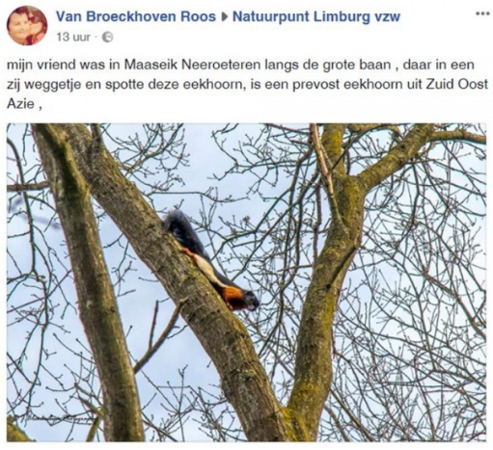
Callosciurus prevosti,

Slide 17
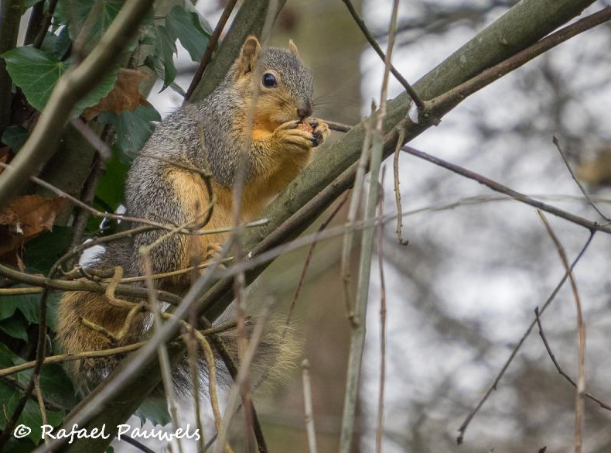
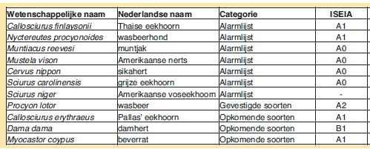
Sciurus niger, Terhulpen, 2015

Slide 18
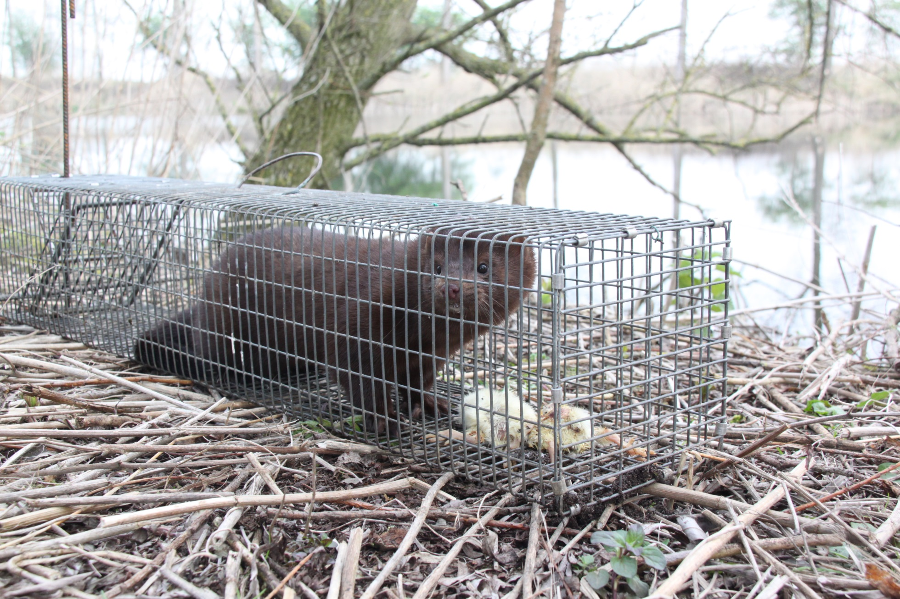
Neovison vison, Moerbeke, 2014,

Slide 19
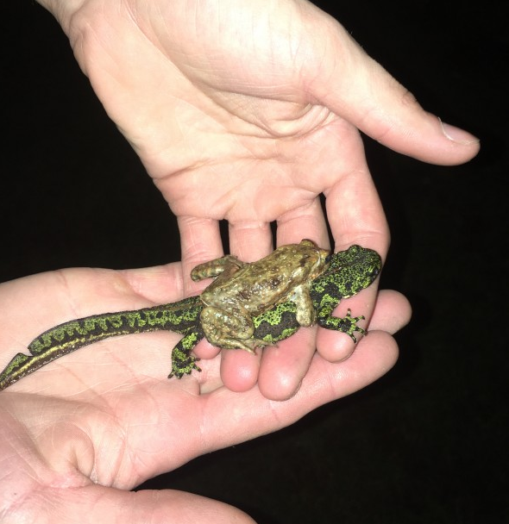
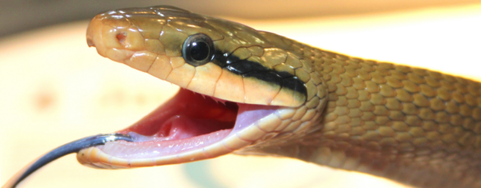
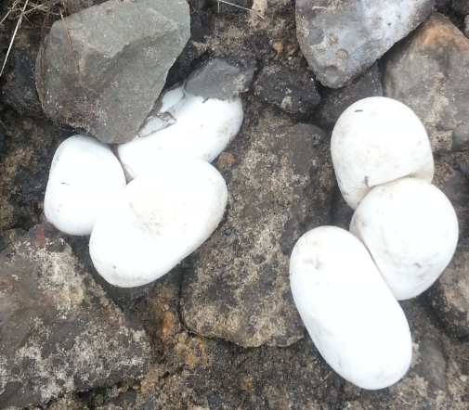
Escapees
Orthriophis taeniurus
Triturus marmoratus, Lochristi 2018
Notes:
Come in through a number of pathways, on this graph you can see that we have far better intel on pathways of introduction for plants, but from what we know, the exotic animal section is coming in as stowaways on other good or commodities, on its own (spontaneous dispersal from other places in the non-native range) and a great deal are escapes from zoos, aquaria etc.

Slide 20
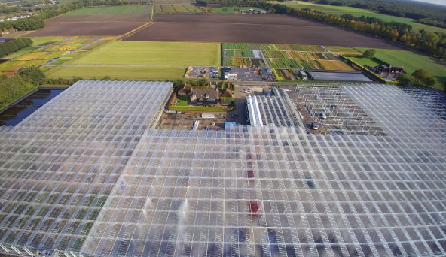
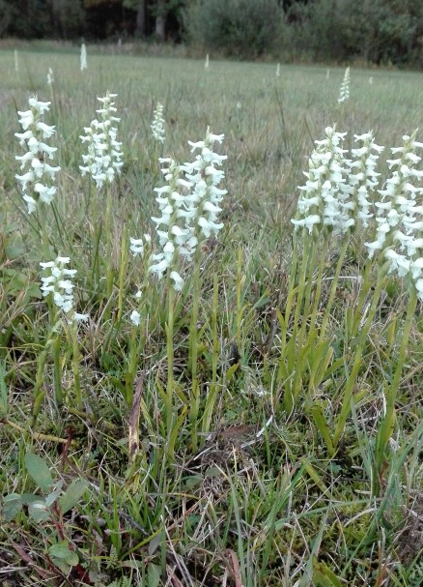
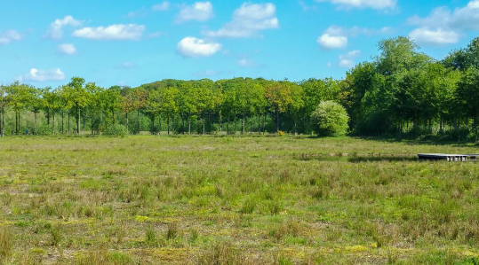
Invasive orchids: weeds we hate to love
Spiranthes cernua x odorata
Notes:
odour

Slide 21
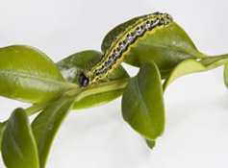
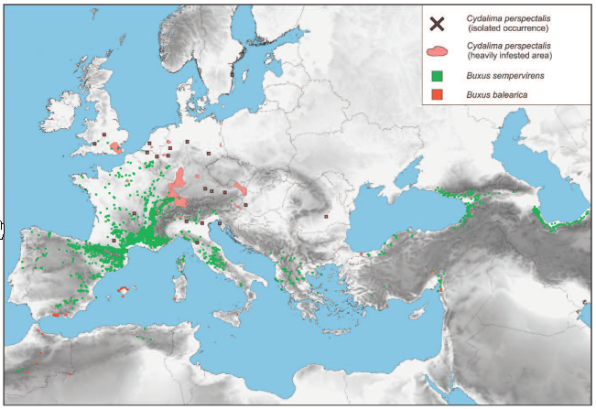
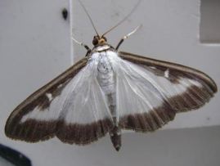
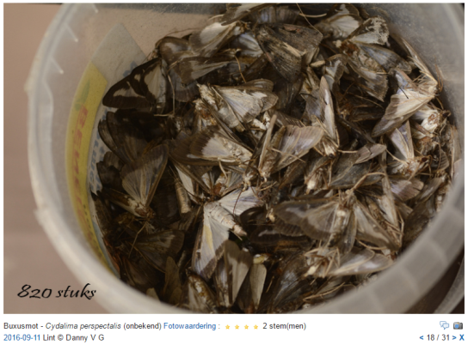
Box tree moth: threat and opportunity ?
Kenis et al. 2013 Aliens
Notes:
Apart from policy initiatives trying to tackle invasives through legislative action (trade bans, prevention, inspection), in the field and the daily practice pf nature management, conservation managers are putting quite some efforts in trying to ensure nature reserves are not turning into zoos and garden centres. This requires…

Slide 22
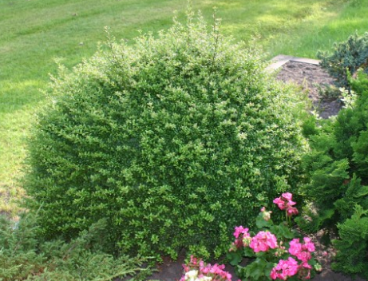
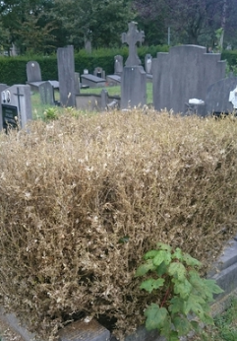
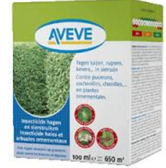
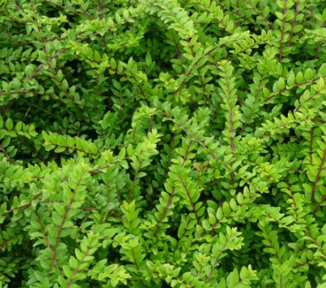
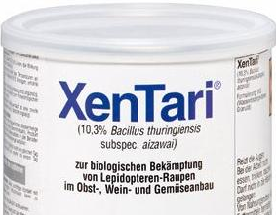
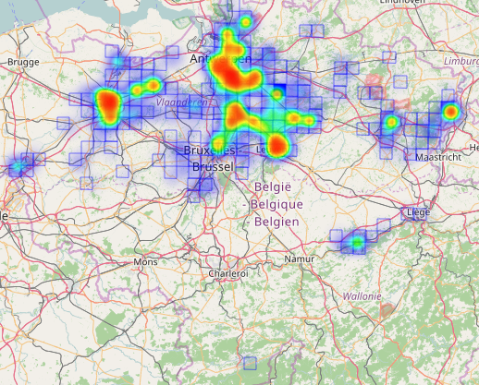
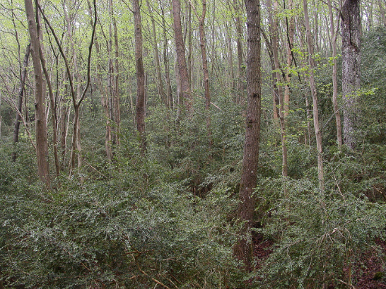
Lonicera nitida
Ilex crenata

Slide 23
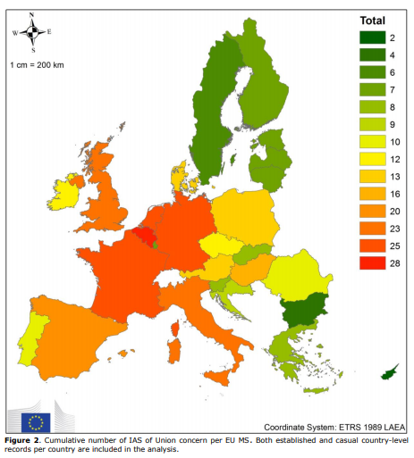
Tsiamis et al. 2017 EASIN – JRC report

Slide 24
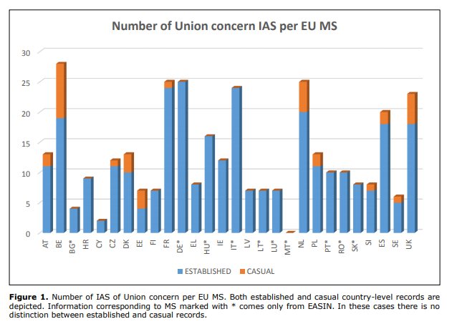
Tsiamis et al. 2017 EASIN – JRC report

Slide 25









Conservation implications
Costly surveillance
Management investment
Smart conservation investment
Prioritizing
Cost-Benefits

Slide 26




Control vs rapid response

Slide 27




Limiting spread
Notes:
Now let’s take a look at this newly adopted legal instrument on the prevention of intro and spread of IAS in Europe. Half asian, half american. The Crayfish are all-American. More than half of the spp are already established in Belgium, however, not in all regions, such as this raccoon. Interestingly, many spp have an impact through pathogen transmission and some are also relevant for human health. Raccoon: reservoir for rabies and vector of baylisascaris.

Slide 28


Approach
Priorizing
Risk assessment
Risk management
Prevention
Awareness raising
www.ecopedia.be
Involve stakeholders
Pathway action plans
Early detection and rapid response
surveillance
Waarnemingen.be/exoten (alerts)
Response actions
Control and mitigation
Best practices
Management regulations
Access to private land
Control actions

Slide 29





Surveillance
Passive surveillance
Waarnemingen.be/exoten alert system (observation.org)
Citizen science, naturalists
Focus on EU lijst but also alert list species
Active surveillance
Points of entry
Protected areas
Involve specific stakeholders
New technologies
Smartphones
e-DNA
Crowdsourcing (camera traps)
Drones
Official monitoring
WFD, Natura2000

Slide 30




Early warning
Citizen science recording platform waarnemingen.be/exoten
ID sheets
Alerts in the mailbox
Smartphone apps: obsmapp, webobs, iObs, winobs, That’s Invasive!

Slide 31



Slide 32



Sacred ibis

Slide 33




Ruddy duck

Slide 34




Asian hornet

Slide 35




Chinese muntjac

Slide 36




Egyptian goose

Slide 37



Harlequin ladybird

Slide 38



(unanticipated) effects of species removal
Compensatory increases in other IAS

Slide 39




Slide 40










Slide 41



Better late than never, but never late is better
Kueffer et al. 2013 New Phytologist

Slide 42

Case: rapid responsed invaders
rapid eradication of Pallas squirrel
Notes:
Enkele kenmerken bespreken en verschil met rode eekhoorn duiden

Slide 43

Notes:
Enkele kenmerken bespreken en verschil met rode eekhoorn duiden

Slide 44





Pallas squirrel
© Maurice La Haye
Callosciurus erythraeus
Arboreal species native to Asia
High densities (up to 15 ind/ha)
Competition with European red
Invasive in Argentina, Japan, Antibes
Damage: bark stripping, cables
Notes:
Voorpagina Belgsiche PRA

Slide 45


Slide 46






Invasion history
Origin, date and pathway of introduction unclear
Animals escaped from private collection/shop/funfair
Present since 2004 (?)
In the park (Marienstede) and the surrounding gardens
Initially misidentified as Sciurotamias davidianus
Genetic analysis
2005: immediate action (45 animals) by the site manager
2007: recognition of the problem → ANB, INBO

Slide 47


Dadipark
Mariënstede

Slide 48




Notes:
Foto van de soorten tonen en beetje over de verspreiding praten

Slide 49


Lettre du ministre
Une décision est prise
Responsabilités
Finances
Animal welfare
Legale
communication
Surveillance (cameras)
Capture: nut-baited mesh wire life traps (4-9 ha⁻¹)
Humane killing using carbon dioxide
5 campagnes de capture (2005- 2011)
1,5 yr surveillance après l’éradication!

Slide 50





Slide 51


Slide 52


Notes:
Caveties in the trunks and major branches

Slide 53

Notes:
Open to the public – walkers, bikers and joggers

Slide 54

Notes:
Dense canopy

Slide 55

Notes:
Foto van de soorten tonen en beetje over de verspreiding praten

Slide 56

Eradication
2005: captures by site manager
2007: a decision is taken
Responsabilities
Budget
Animal welfare
Communication
Methodology:
Surveillance (camera traps)
Captures: nut-baited mesh wire life traps (4-9 ha⁻¹)
Before the breeding season
Humane killing using carbon dioxide
1,5 years post-eradication monitoring

Slide 57

Notes:
Foto van de soorten tonen en beetje over de verspreiding praten

Slide 58





Slide 59




Notes:
Foto van de soorten tonen en beetje over de verspreiding praten

Slide 60




Notes:
Foto van de soorten tonen en beetje over de verspreiding praten

Slide 61

Results

Slide 62

Results
??
Research Group on Rodent Management

Slide 63
Budget

Slide 64
Budget

Slide 65
Success factors
Early invasion stage
Initial density estimated at 3.1 (2;3.3 95%CI) ha-1
Corresponds with initial # of 47 (44.5; 48.8)
Reaction time < 1.5 yrs
Insular context, “community-based” eradication
Trap happy species, simple and low-tech method
No native red squirrel (little bycatch issues)
Perseverance of trappers
Low probability of reintroduction (Dadipark closed in 2002)
Lead like a scientific project
Little public opposition
Initially dispatched to zoo
Humane killing professionally executed
Corpses used for scientific research
Locally initiated
Political support (HCNC + minister)

Slide 66


Insular context
Robertson et al. 2016 Pest Management Science

Slide 67

Suggestions for improvement
Initial misidentification slowed down response
No contingency plan
No coordination of rapid response
Lack of experience
Considerable time & resources
Consistency of reporting on catch effort

Slide 68

Situation in Europe

Slide 69




Other species of concern
On the list of species of EU concern sensu IAS Regulation
Sciurus carolinensis
Sciurus niger
Tamias sibiricus
In expansion
Callosciuru finlaysonii
Notes:
Foto van de soorten tonen en beetje over de verspreiding praten

Slide 70

Case: established invasives
bullfrog management through habitat manipulation
Notes:
Enkele kenmerken bespreken en verschil met rode eekhoorn duiden

Slide 71
Mindset
Simple IS removal can be ineffective without holistic view on ecosystem
Restoration (if any) can facilitate new invasions
Exceeds local scale
High initial investment
Takes time (which the ecosystem does not have)
Deal with public acceptation
managing the whole biotic community to reduce invasion impacts (“mitigation”)
restoring ‘healthy ecosystem’ rather than species removal
aims at increasing ecosystem resilience to biological invasions

Slide 72



Life history traits
Continuous gonadal development
Long reproductive period
High fecundity
High mean survival rate tadpoles
Flexible life-history
Broad habitat & food range
Few control agents
Notes:
Relevant with regards to management

Slide 73

Impact
Resource competition
Tadpoles compete for algal resources
Inhibiting growth and development NS
Altered microhabitat use NS
Predation
Pathogen transmission
Chytrid (Bd)
Ranavirosis (FV)
Amphibiichlamydia
Ecosystem-level effects
Primary production phytoplankton
Changes in species composition
Food webs disruption
Facilitation NN fish
Additional pressure on already declining amphibian populations
Notes:
Well demonstrated in larval stage
Inhibiting growth and development (size at metamorphosis, survival)
Altered microhabitat use NS suboptimal
Reproductive interference
Implicated in mass mortalities e.g. midwife toads

Slide 74

American bullfrog Lithobates catesbeianus
Global Amphibian Assessment (http://maps.iucnredlist.org)
Santos-Barrera et al., 2011

Slide 75

most important populations
Report EEA, Scalera et al. (2012)

Slide 76

Distribution
Hyla, INBO (Invexo), De Wavrin et al. (2007), Martin (2009)

Slide 77


Distribution
Hyla, INBO (Invexo)

Slide 78


Slide 79

Notes:
Turbid state, aquatic es has gone beyond a tipping point, bad ecological status, hardly anything in there besides invasive fish and bullfrog (passenger-driver)

Slide 80

Notes:
100ds of private ponds where local autority has nothing to say, large interconnected metapopulation

Slide 81
Management in Flanders
Prevention
Risk assessment for Belgium
WTR appendix B since 1997
EU Reg IAS
Eradication of periferous populations near border with NL
Drawdown + seine netting
Pond destruction
Early warning through citizen science
Containment of the main river valley stronghold
Active trapping using double fyke nets
Some nightlighting
Mitigation
Biomanipulation
Pike introduction to reduce tadpole numbers
Notes:
I’ve put prevention up last because…

Slide 82
Management strategy
Eradication + early warning
X
X
?
Containment + mitigation
?
Hyla, INBO (Invexo)
Notes:
Numerous reproductive nuclei

Slide 83



Management challenge
Strong density dependence in tadpoles
Strong cannibalism of adults on metamorphs
Metamorphs disperse on land
Facilitation by presence of non-native fish
Govindarajulu et al. (2005) Ecol Appl

Slide 84

Notes:
Seine netting - Mind the fencing

Slide 85

Notes:
End up with muddy substance here which is full of first stage larvae

Slide 86

Notes:
Mention fencing!

Slide 87




Slide 88





Slide 89

Density
Average pond:
25.000 (1000-100.000) tadpoles
3 (0-33) metamorphs
5 (0-20) adults; 4adults per 100m shore length
1 CPUE good measure of density (r²= 0.98, p <0.001)
Placement in pond
Notes:
Some variation on bullfrog densities in ponds, yet…

Slide 90

Catchability
Fairly consistent
6% (SE 1, 2-11) for tadpoles
0.7% for adults

Slide 91

Mitigation
Aftercare
Introduction of native predator
removal benthivorous/planktivorous fish
Effect on bullfrog ?
Effects on community structure ?
Notes:
Pike = the “barn owl” of freshwater ecosystems

Slide 92





Results
No effect of drawdown (recolonisation)
Effect on bullfrog larvae

Slide 93


Community structure

Slide 94
Overall effects of biomanipulation
Increased zooplankton
Increased grazing on phytoplankton
Direct predation on tadpoles
Predation on facilitating species (TG, PS)
Indirect effects:
Nicer habitat with reduced turbidity
More macrophytes
More macro-invertebrates predating on tadpoles

Slide 95

To do’s
Drastically upscale management
Formalize rapid response mechanism
Management plan
Funding
Scientific follow-up
Landscape ecology
Network analysis
Intensify monitoring
Organize targeted surveillance
Draft population models with regional parameters
Upscale monitoring (e-DNA)
Horizon scan novel techniques
Capturing post-metamorph
Sterile male release
Best practice for pond owners and managers

Slide 96

Where are we with managing IAS
Horizon scanning
++ Some information available
-- Not on a regular basis
Risk assessment
++ good protocols (ISEIA, Harmonia+)
-- they are not updated/used
Surveillance
++ good passive surveillance with naturalists
-- little active surveillance, specific stakeholders are lacking

Slide 97


Where are we in Belgium with IAS
Invasion literacy
-- Awareness is (very) low
-- Invasion denialism is a growing trend
-- Fatigue amongst volunteers and managers
Biosecurity
++ pathway action plans in the making
-- biosecurity is virtually non-existent

Slide 98






Where are we in Belgium with IAS
Management
++ Embryonic community of practice
++ Manageability < Union List Species
-- too much focus on Union list?
-- lack of coordination
-- Lack of ambition
On the ground capacity for management
++ pathway action plans in the making
++ dedicated projects
++ Social economy companies
++ Volunteer involvement
-- Private initiatives and businesses
-- Government rapid response team

Slide 99

Thank you !
Wildlife Management & Non-native species team
Research Institute for Nature and Forest (INBO)
Kliniekstraat 25, B-1070 Brussel
tel +32 2 525 02 04 | gsm +32 496 62 61 78
tim.adriaens@inbo.be
@AdriaensTim

Slide 100


Risk management
Effectiveness
Practicality
Cost
Acceptability
Negative effects
Window of opportunity
Likelihood reintroduction
Notes:
Now let’s take a look at this newly adopted legal instrument on the prevention of intro and spread of IAS in Europe. Half asian, half american. The Crayfish are all-American. More than half of the spp are already established in Belgium, however, not in all regions, such as this raccoon. Interestingly, many spp have an impact through pathogen transmission and some are also relevant for human health. Raccoon: reservoir for rabies and vector of baylisascaris.

