Slide 1

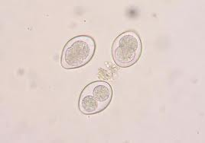
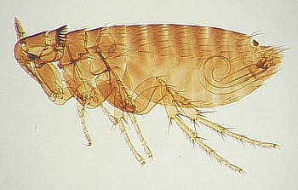
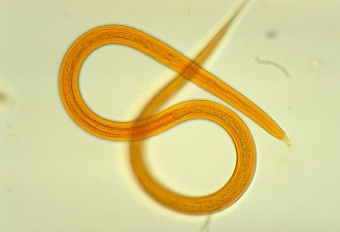
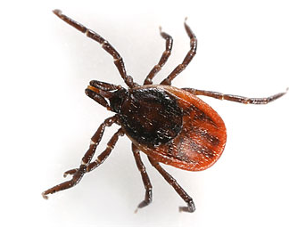
Gli scoiattoli alloctoni e altre specie invasive: impatti ed esperienze di gestione a confronto - Progetto LIFE U-SAVEREDS
Perugia, 11-13 Aprile 2018
Alien squirrels & diseases:
implications and threats
C. Romeo
Department of Veterinary Medicine, Università degli Studi di Milano (claudia.romeo@unimi.ti)
DIPARTIMENTO DI
MEDICINA VETERINARIA

Slide 2

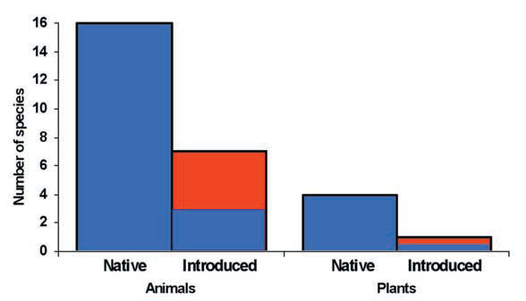
Alien species & parasites
1. PARASITE LOSS
Invaders often lose part of their parasite community during invasion (e.g. founder effect, drugs during captivity, no intermediate hosts, etc.)
They will benefit from this loss in terms of fitness
Improved performances in the new range compared to the native range
ENEMY-RELEASE HYPOTHESIS
(Torchin & Mitchell, Front Ecol Environ, 2004)

Slide 3
Alien species & parasites
2. ALIEN PARASITE
INTRODUCTION
3. LOCAL PARASITE
ACQUISITION
spillover to naive native species
alteration of pre-existent epidemiology
and spill-back
to native species
competition mediated by shared natural enemies
APPARENT COMPETITION

Slide 4
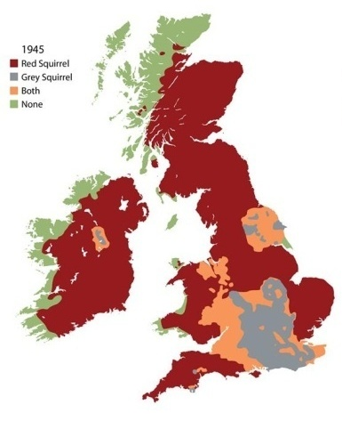
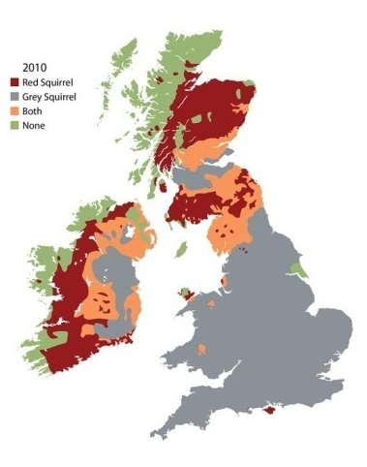
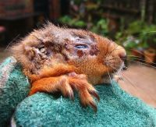
Alien squirrels & parasites
SQUIRRELPOX VIRUS mediates the competition between red & grey squirrels in Great Britain & Ireland
Grey squirrel:
healthy carrier (prevalence ∼60%)
Red squirrel:
lethal in most cases
replacement accelerated up to ∼ 25 times
Photo credit: Sarah McNeil

Slide 5
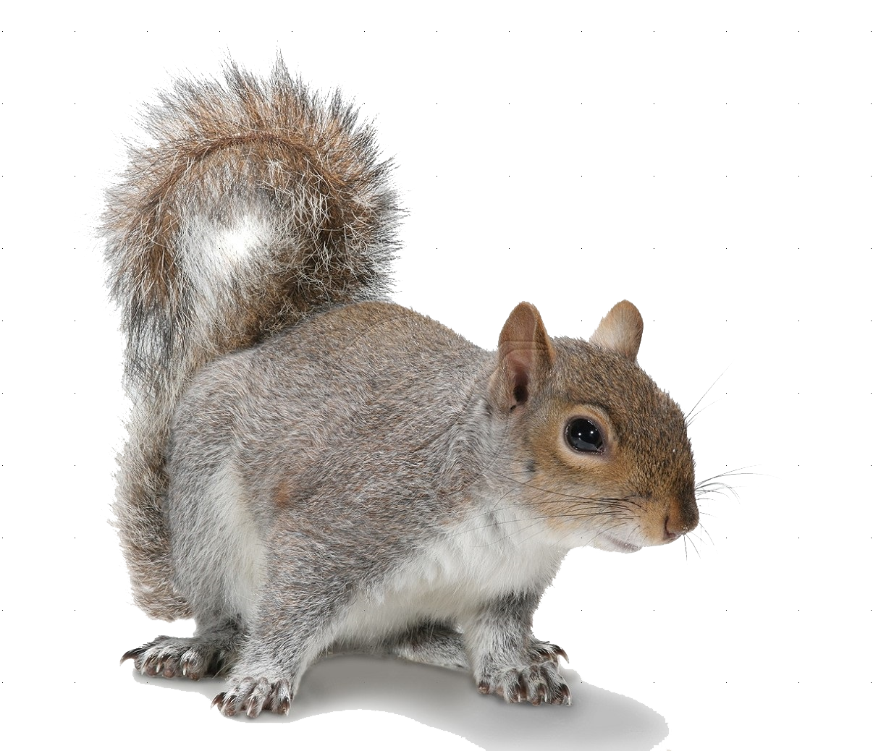
Squirrelpoxvirus in Italy?
Serology (n=285) + molecular (n=66) (2011-2014)
ELISA: 4 positive reactors (cross-reactions!)
PCR: all negative
No evidence of SQPV in Italian grey squirrel populations
however, passive surveillance is recommended
(Romeo et al., An Cons, under review)

Slide 6
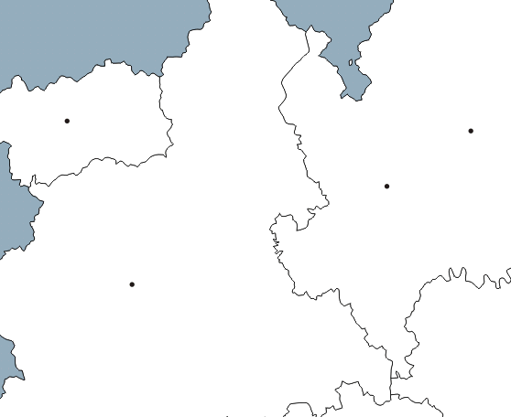
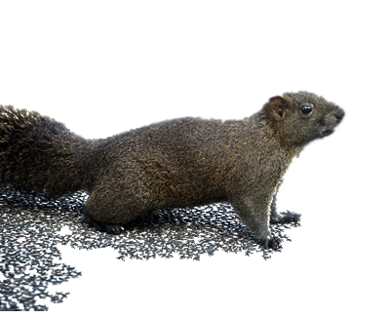
Alien squirrels & parasites
Did alien squirrel introduced to Italy lose, acquire or carry along any parasite species?
Grey squirrel:
7 sites
(2011-2013)
Pallas’ squirrel:
1 site
(2011-2014)
Milano
Torino
Direct parasitological survey through PM examination of carcasses

Slide 7
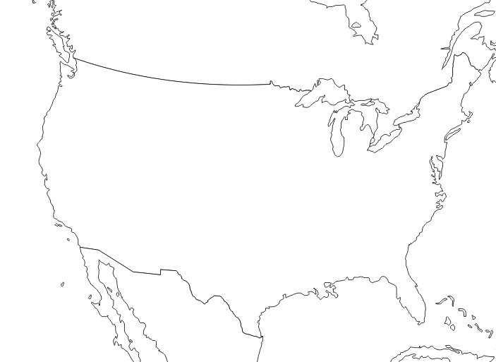
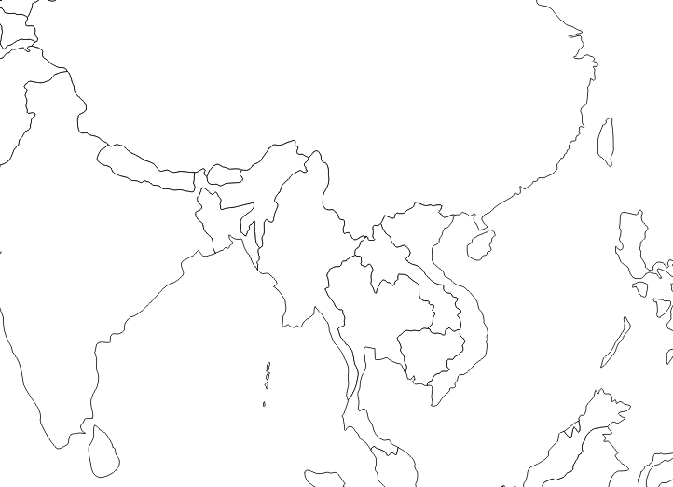
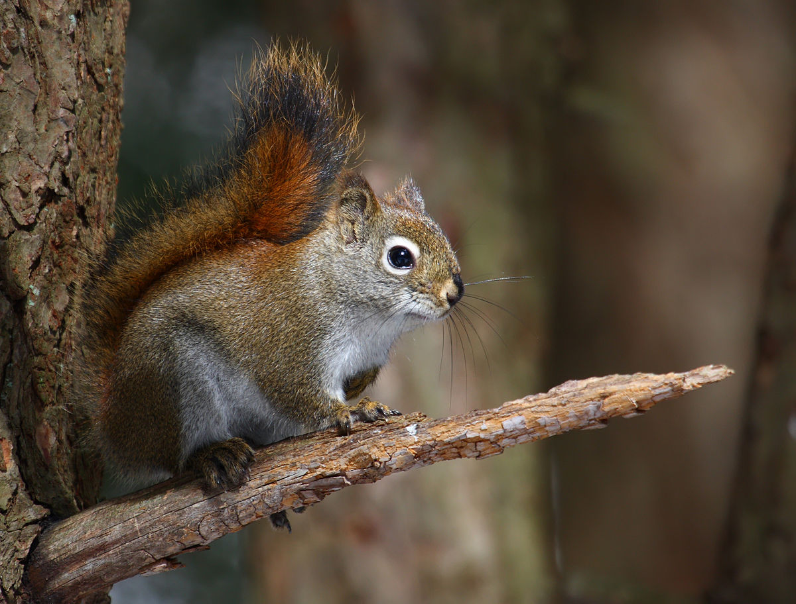
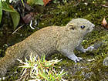
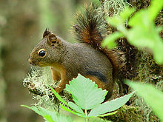
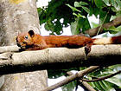
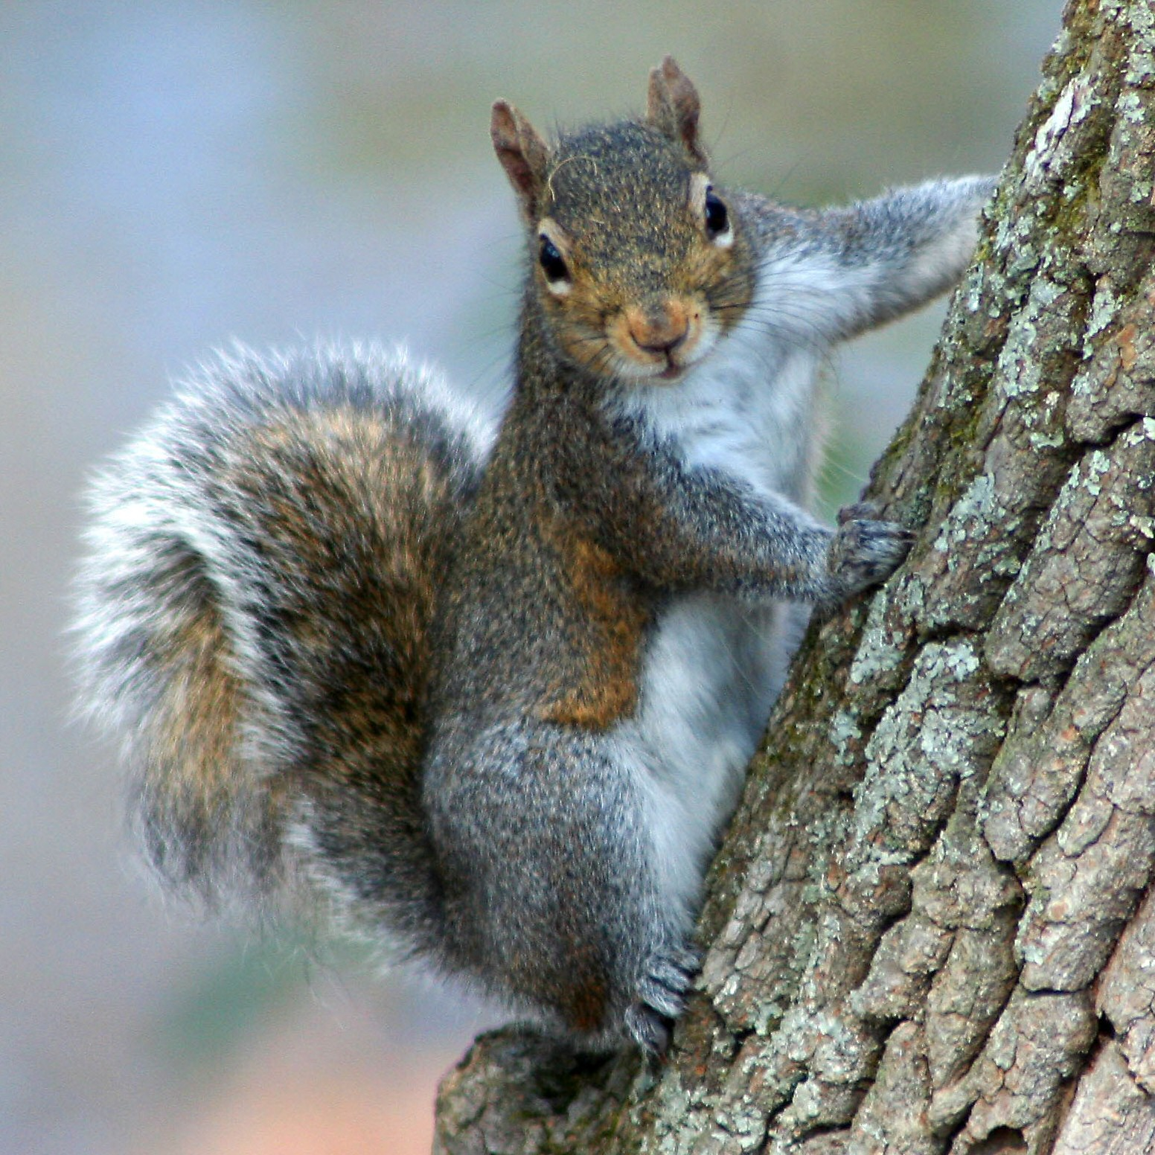
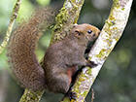
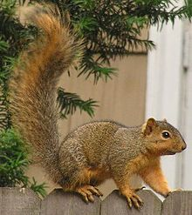
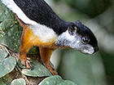
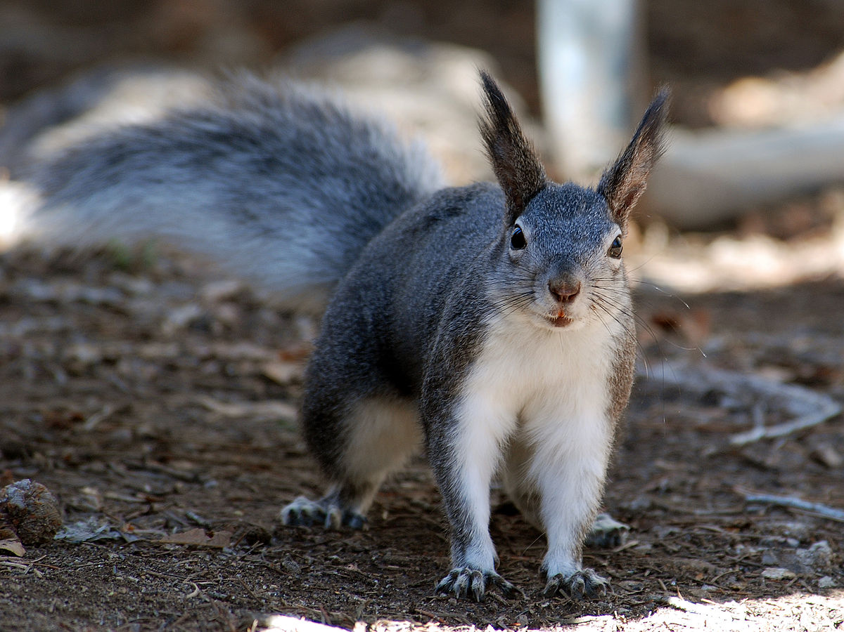
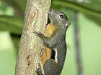
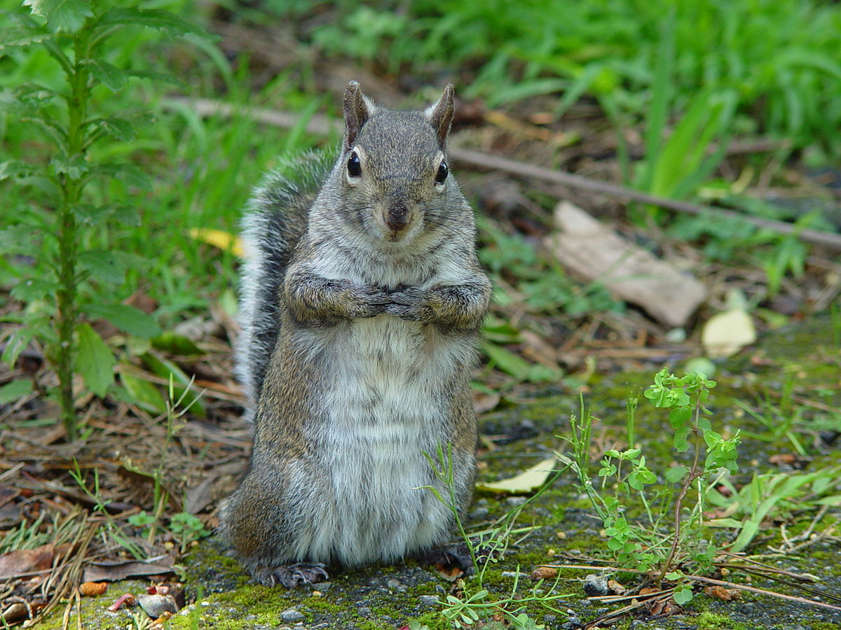
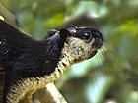
Alien squirrels & parasites
Rich Host Community = Rich Parasite Community

Slide 8
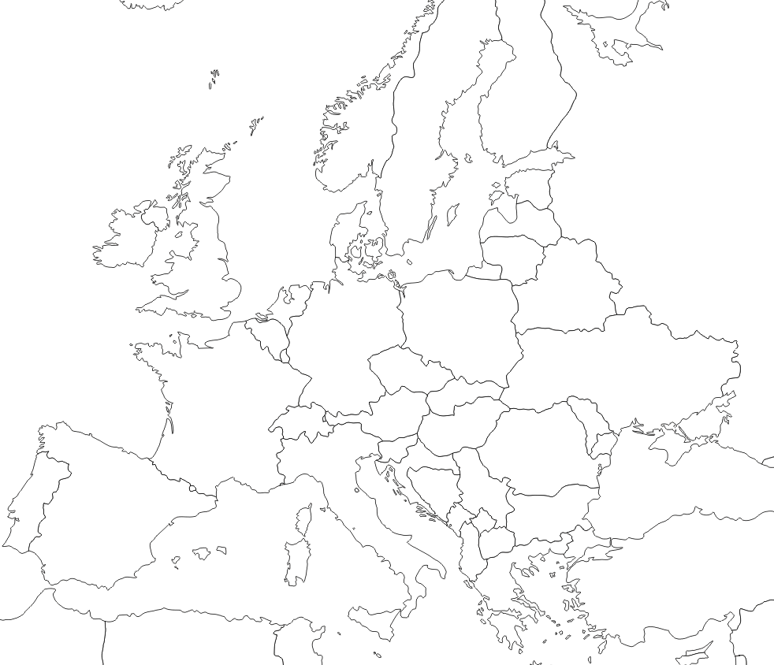
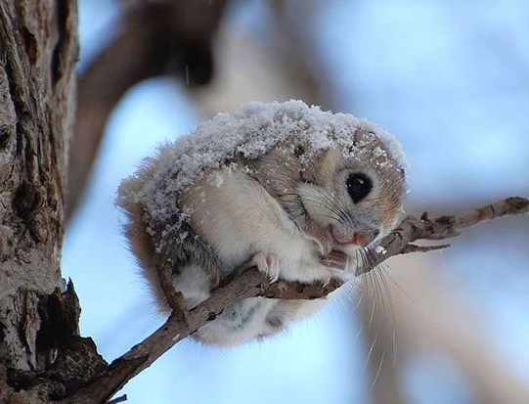
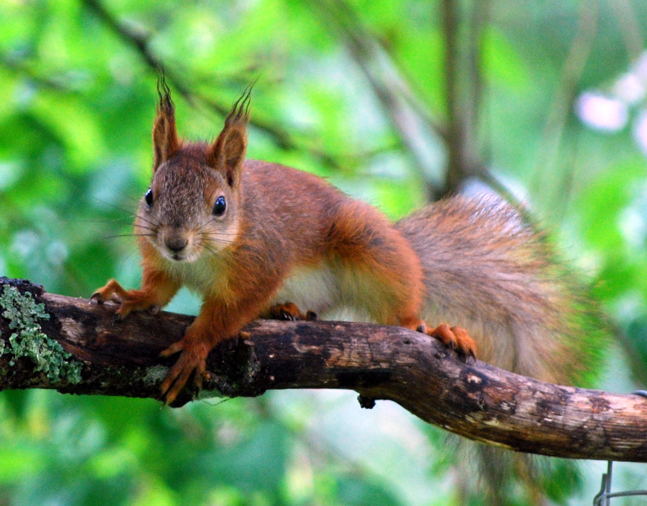
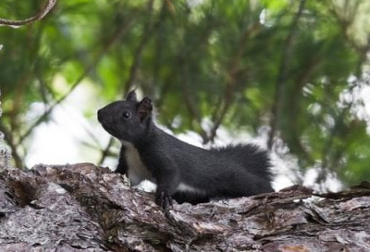
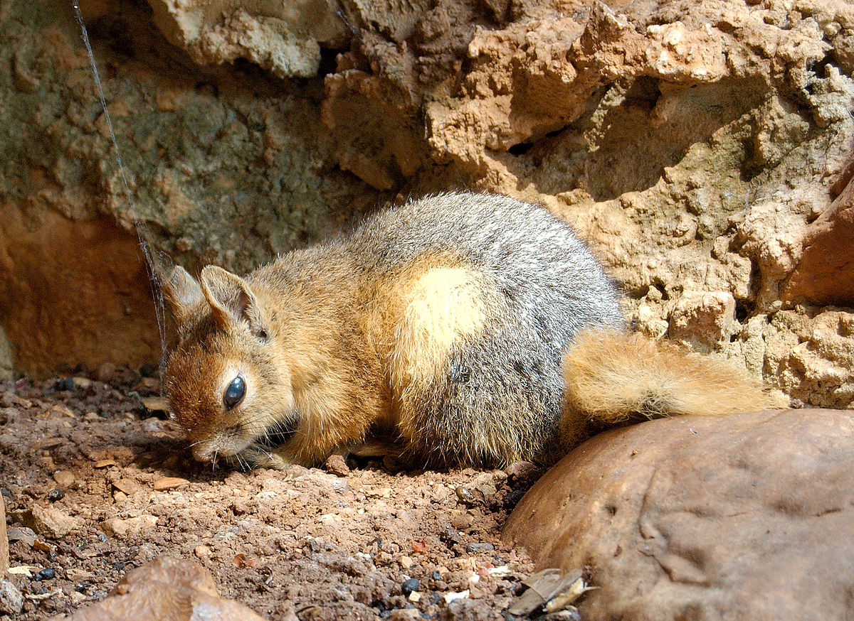
Alien squirrels & parasites
POOR PARASITE COMMUNITY
e.g. a single gastro-intestinal, scarcely pathogenic
helminth species:
Trypanoxyuris sciuri
(> 80% prevalence)
Vulnerability to Spillover?
(Romeo et al., Parasitol Res, 2013)

Slide 9

Endoparasites – Helminths
Taxon | Prevalence | Mean Intensity
Strongyloides robustus | 56.5% | 16.9 ± 2.1
Trichostrongylus calcaratus | 6.5% | 1.9 ± 0.3
Trichuris muris | 4.2% | 1.3 ± 0.2
Trypanoxyuris sciuri | 1.9% | 80 ± 2.5
Aonchotheca annulosa | 1.5% | 2.2 ± 0.6
n=262
(Romeo et al., PloS ONE 2014)
Taxon | Prevalence | Mean Intensity
Trypanoxyuris sciuri | 5.5% | 2.3 ± 1.3
Trichuris muris | 5.5% | 1
Strongyloides callosciureus | 2.7% | 1
n=73
(Mazzamuto et al., Ann Zool Fenn 2016)

Slide 10
Endoparasites – Helminths
Both species harbour
poor helminth
communities
POTENTIAL FOR ENEMY-RELEASE
Grey squirrels successfully introduced the nematode
S. robustus
SPILLOVER TO NATIVE SPECIES?
Grey and Pallas’ squirrels rarely acquire red squirrels’
T. sciuri
SPILL-BACK UNLIKELY

Slide 11
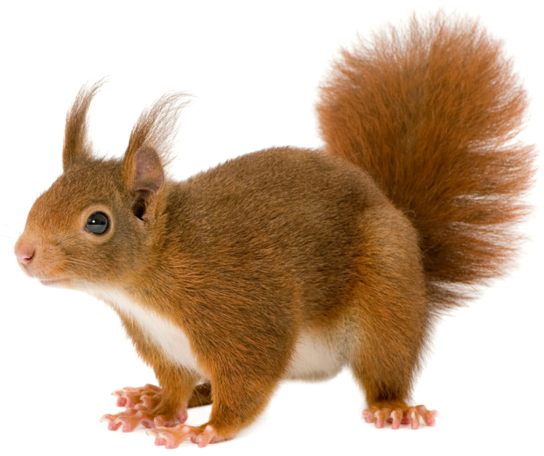
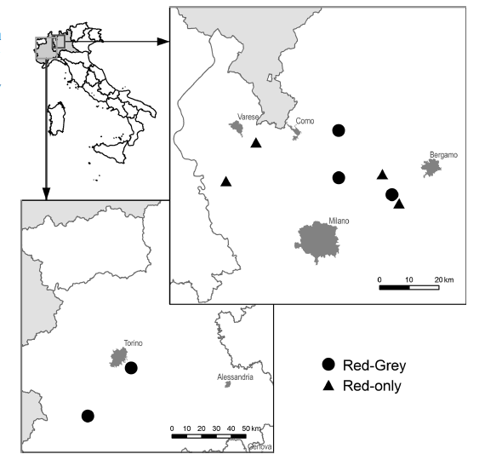
Endoparasites – Helminths
4 red-only sites (n=60)
5 red-grey sites (n=49)
Extensive live-trapping
(2011-2013)
Faecal examination for S. robustus + tape tests for T. sciuri
(Romeo et al., Parasitol Res 2015)

Slide 12
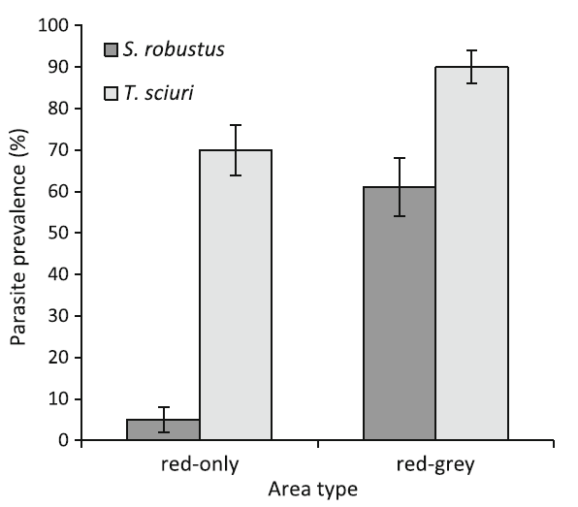
Endoparasites – Helminths
In areas co-inhabited by grey squirrels, red squirrels have a higher probability of being infected by both S. robustus and T. sciuri (p<0.05)
S. robustus egg
T. sciuri egg
(Romeo et al., Parasitol Res 2015)

Slide 13
Endoparasites – Helminths
Spillover of S. robustus from grey to red squirrels
WHAT IS THE IMPACT ON RED SQUIRRELS?
S. robustus has
high prevalence in red squirrels which shed viable eggs
RED SQUIRRELS ACT AS COMPETENT HOSTS
In the presence of grey squirrels, red squirrels also suffer increased infection by T. sciuri
STRESS-MEDIATED EFFECTS ON IMMUNE RESPONSE?

Slide 14
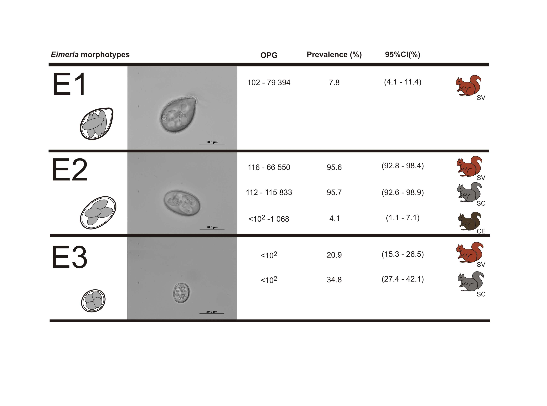
Endoparasites – Coccidia
Most of red & grey squirrels are infected by coccidian (e.g. E2 > 90%)
Pallas’ squirrels likely lost their coccidian parasites
Molecular analysis revealed that E2 are actually two distinct species: E. sciurorum in red squirrels and N. American
E. lancasterensis in grey squirrels
DATA SUGGEST NO INTERSPECIFIC TRANSMISSION
(Hofmannová et al., Eu J Protistol, 2016)

Slide 15
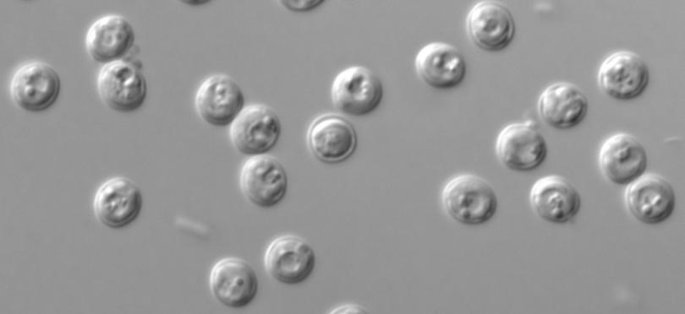
Endoparasites – Cryptosporidium
Squirrel species | Prevalence | Taxa
RED (n=123) | 10.7% | Ferret genotype
GREY (n=162) | 3.7% | Chipmunk genotype I Skunk genotype C. ubiquitum
PALLAS’ (n=72) | 2.8% | Chipmunk genotype I
DATA SUGGEST NO INTERSPECIFIC TRANSMISSION
(Prediger et al., Eu J Protistol, 2017)

Slide 16
Ectoparasites
n=231
Taxon | Prevalence | Mean Intensity
Ceratophyllus sciurorum | 26.5% | 2.7 ± 0.3
Neaohaemathopinus sciuri | 17.7% | 3.6 ± 0.8
Ixodes acuminatus | 1.7% | 1
Ctenocephalides felis | 0.4% | 1
(Romeo et al., PloS ONE 2014)
Taxon | Prevalence | Mean Intensity
Ceratophyllus sciurorum | 50% | 1.0 ± 0.1
Ixodes ricinus | 47% | 3.0± 0.7
n=135
(Mazzamuto et al., Ann Zool Fenn 2016)

Slide 17
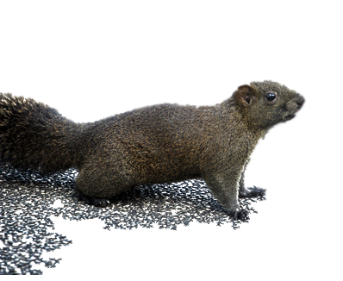
Ectoparasites
Both species harbour
poor helminth
communities
POTENTIAL FOR ENEMY-RELEASE
Neither grey nor Pallas’
squirrels introduced any
alien parasites
NO SPILLOVER
Both squirrel species successfully acquired local parasites
SPILL-BACK TO NATIVE SPECIES?

Slide 18
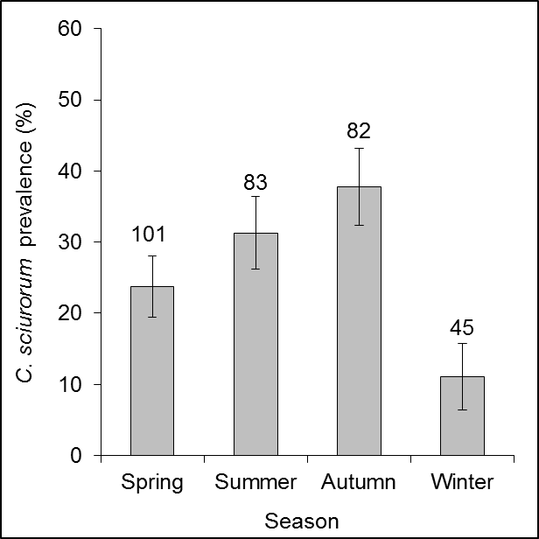
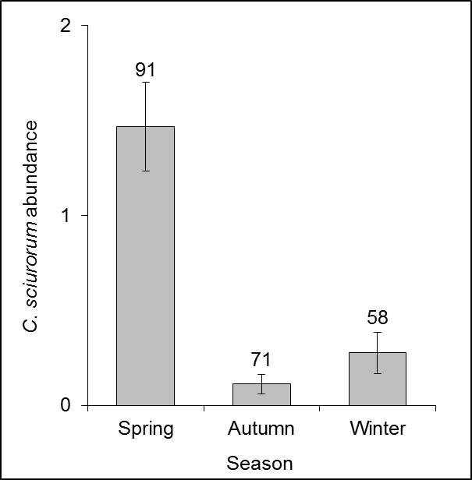
Ectoparasites
Potential alteration of
C. sciurorum seasonal distribution in areas co-inhabited by grey squirrels

Slide 19
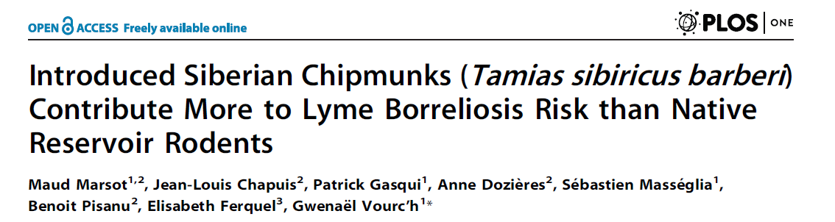
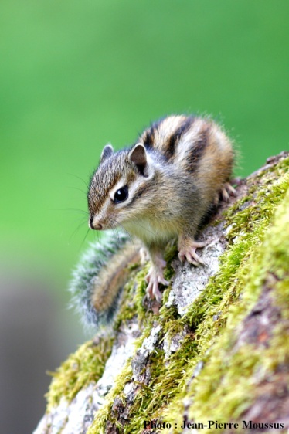
Ectoparasites
Pallas’ squirrels are frequently infected by the hard tick I. ricinus
ALTERATION OF TICK-BORNE PATHOGENS DISTRIBUTION?
POTENTIAL SANITARY THREAT

Slide 20

Conclusions & future perspectives
GOOD NEWS, BUT WE NEED TO REMAIN VIGILANT!
1. No Squirrelpox virus in Italy
2. Parasite loss in both alien squirrel species
ENEMY-RELEASE?
3. Introduction of S. robustus by grey squirrels with spillover to red squirrels
WHAT IS THE IMPACT ON NATIVE SPECIES?
4. Acquisition of the flea C. sciurorum by both alien squirrel species
SPILL-BACK TO NATIVE SPECIES?
5. Acquisition of the tick I. ricinus by Pallas’ squirrels
SANITARY RISK?

Slide 21








Thank you for your attention!
DIPARTIMENTO DI
MEDICINA VETERINARIA

