Slide 1
Water Health Open KnoWledge - WHOW
Co-creation meeting
Carmen Ciciriello
CELERIS

Slide 2
Water Health Open KnoWledge - WHOW
OBJECTIVES
Develop the first European knowledge graph on water consumption and pollution, and link environmental data to health data on disease diffusion to be reused for advanced analysis and development of innovative services.

Slide 3
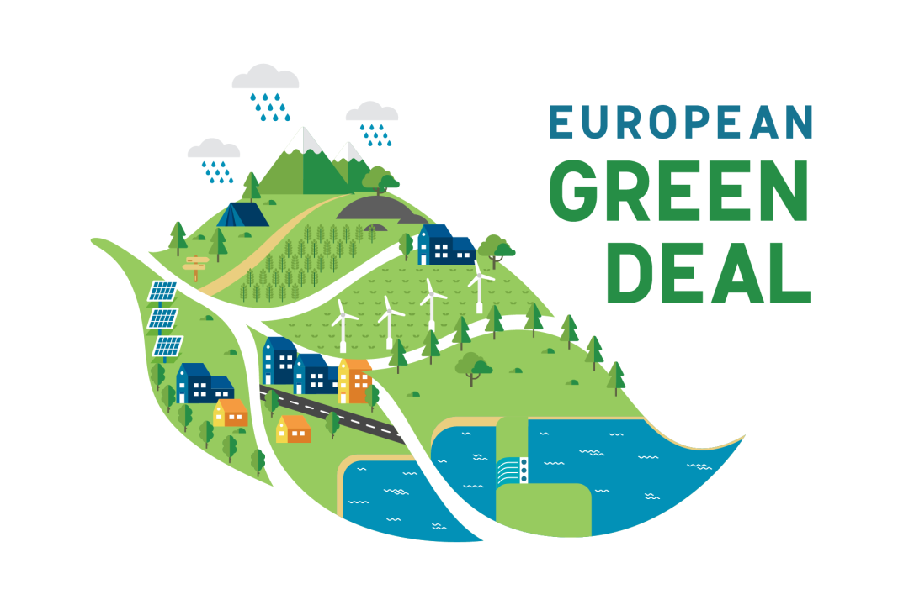
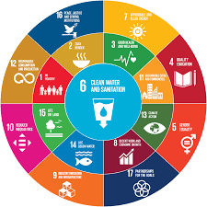
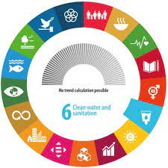
Water Health Open KnoWledge - WHOW
VALUE
Harmonised data for water & health
EU datasets: local, national, EDP, Copernicus New services using Open Data through APIs
Scenarios to measure SDG #6 indicators
Sustainability through co-creation
Stakeholders opportunities

Slide 4
Water Health Open KnoWledge - WHOW
PARTNERS
CELERIS (IE)
Project Co-ordinator
ARIA (IT)
ISPRA (IT)
ISTC-CNR (IT)

Slide 5
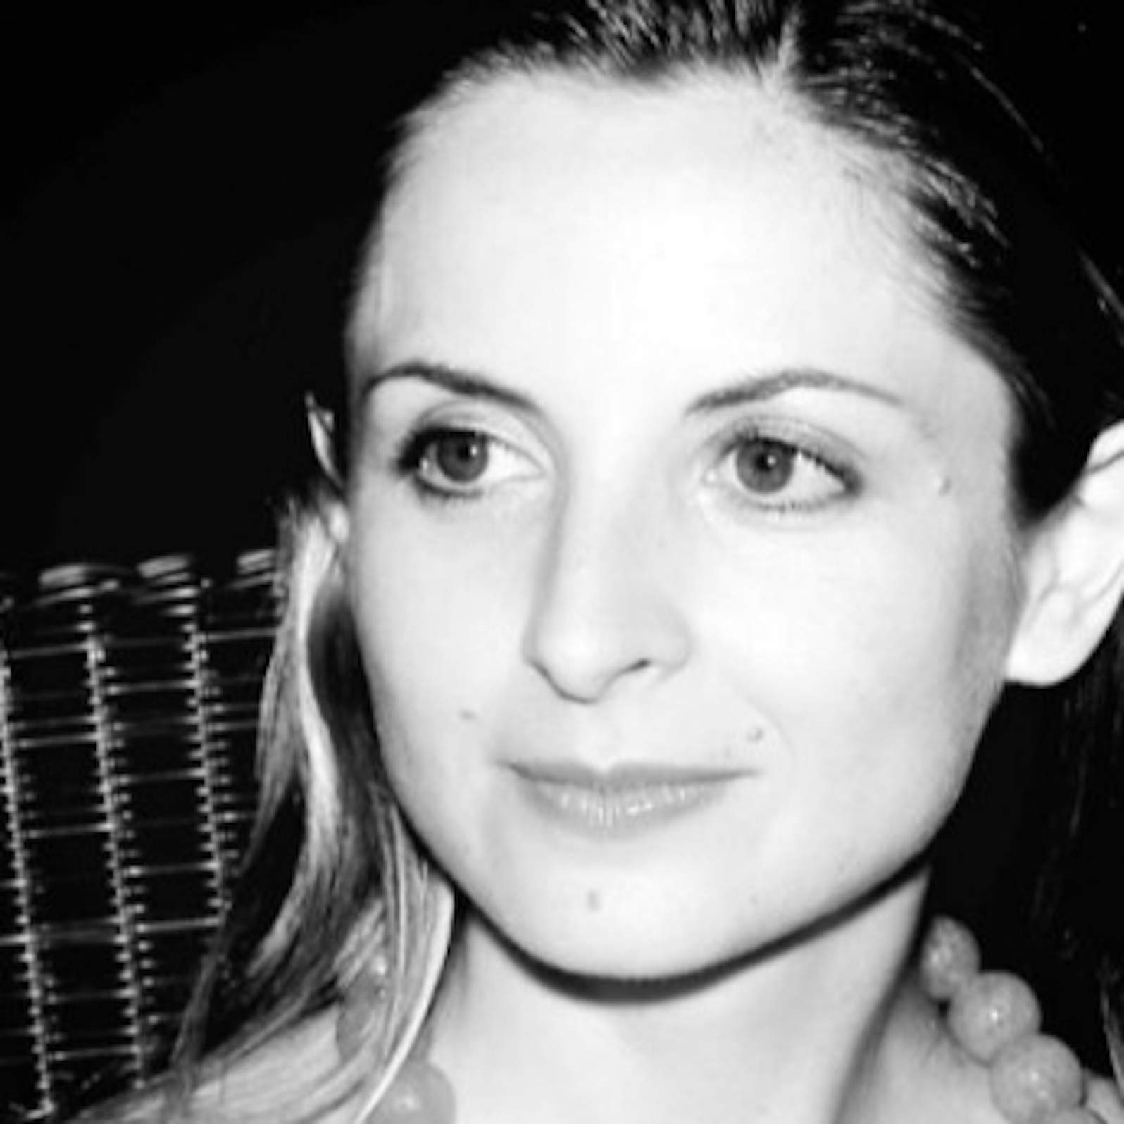
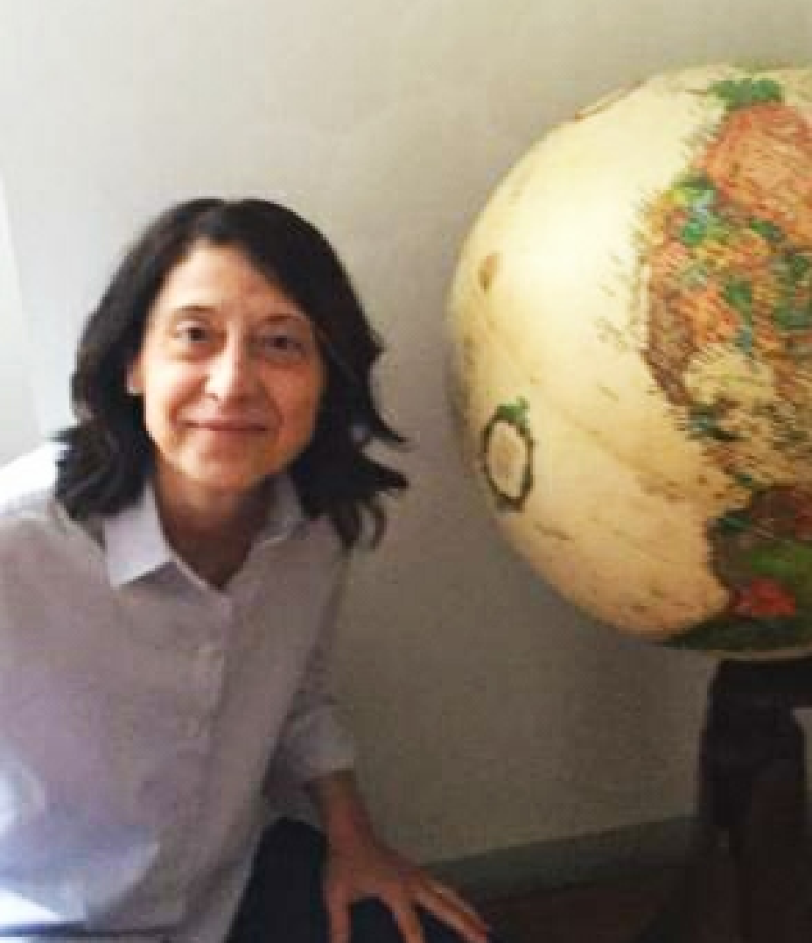
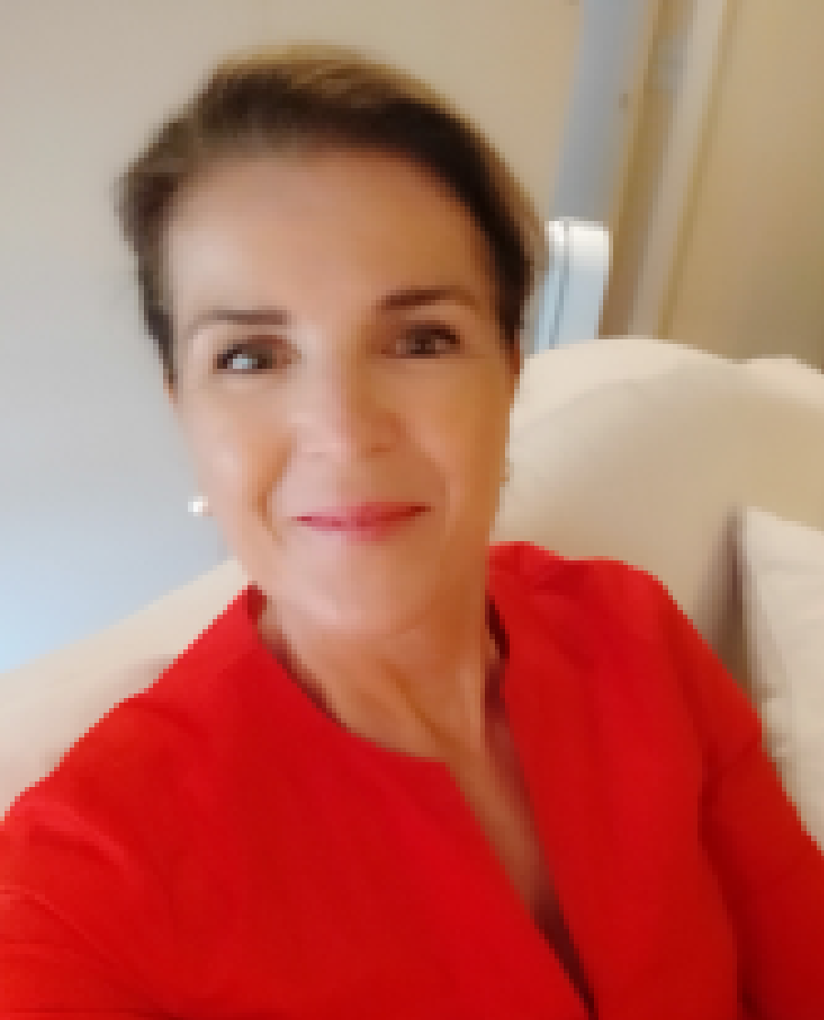
Water Health Open KnoWledge - WHOW
PEOPLE
Celeris Advisory
Carmen Ciciriello
Project Coordinator
Paola Rita Esposito
Legal Expert - Water
Anna Pasian
SDGs Expert

Slide 6
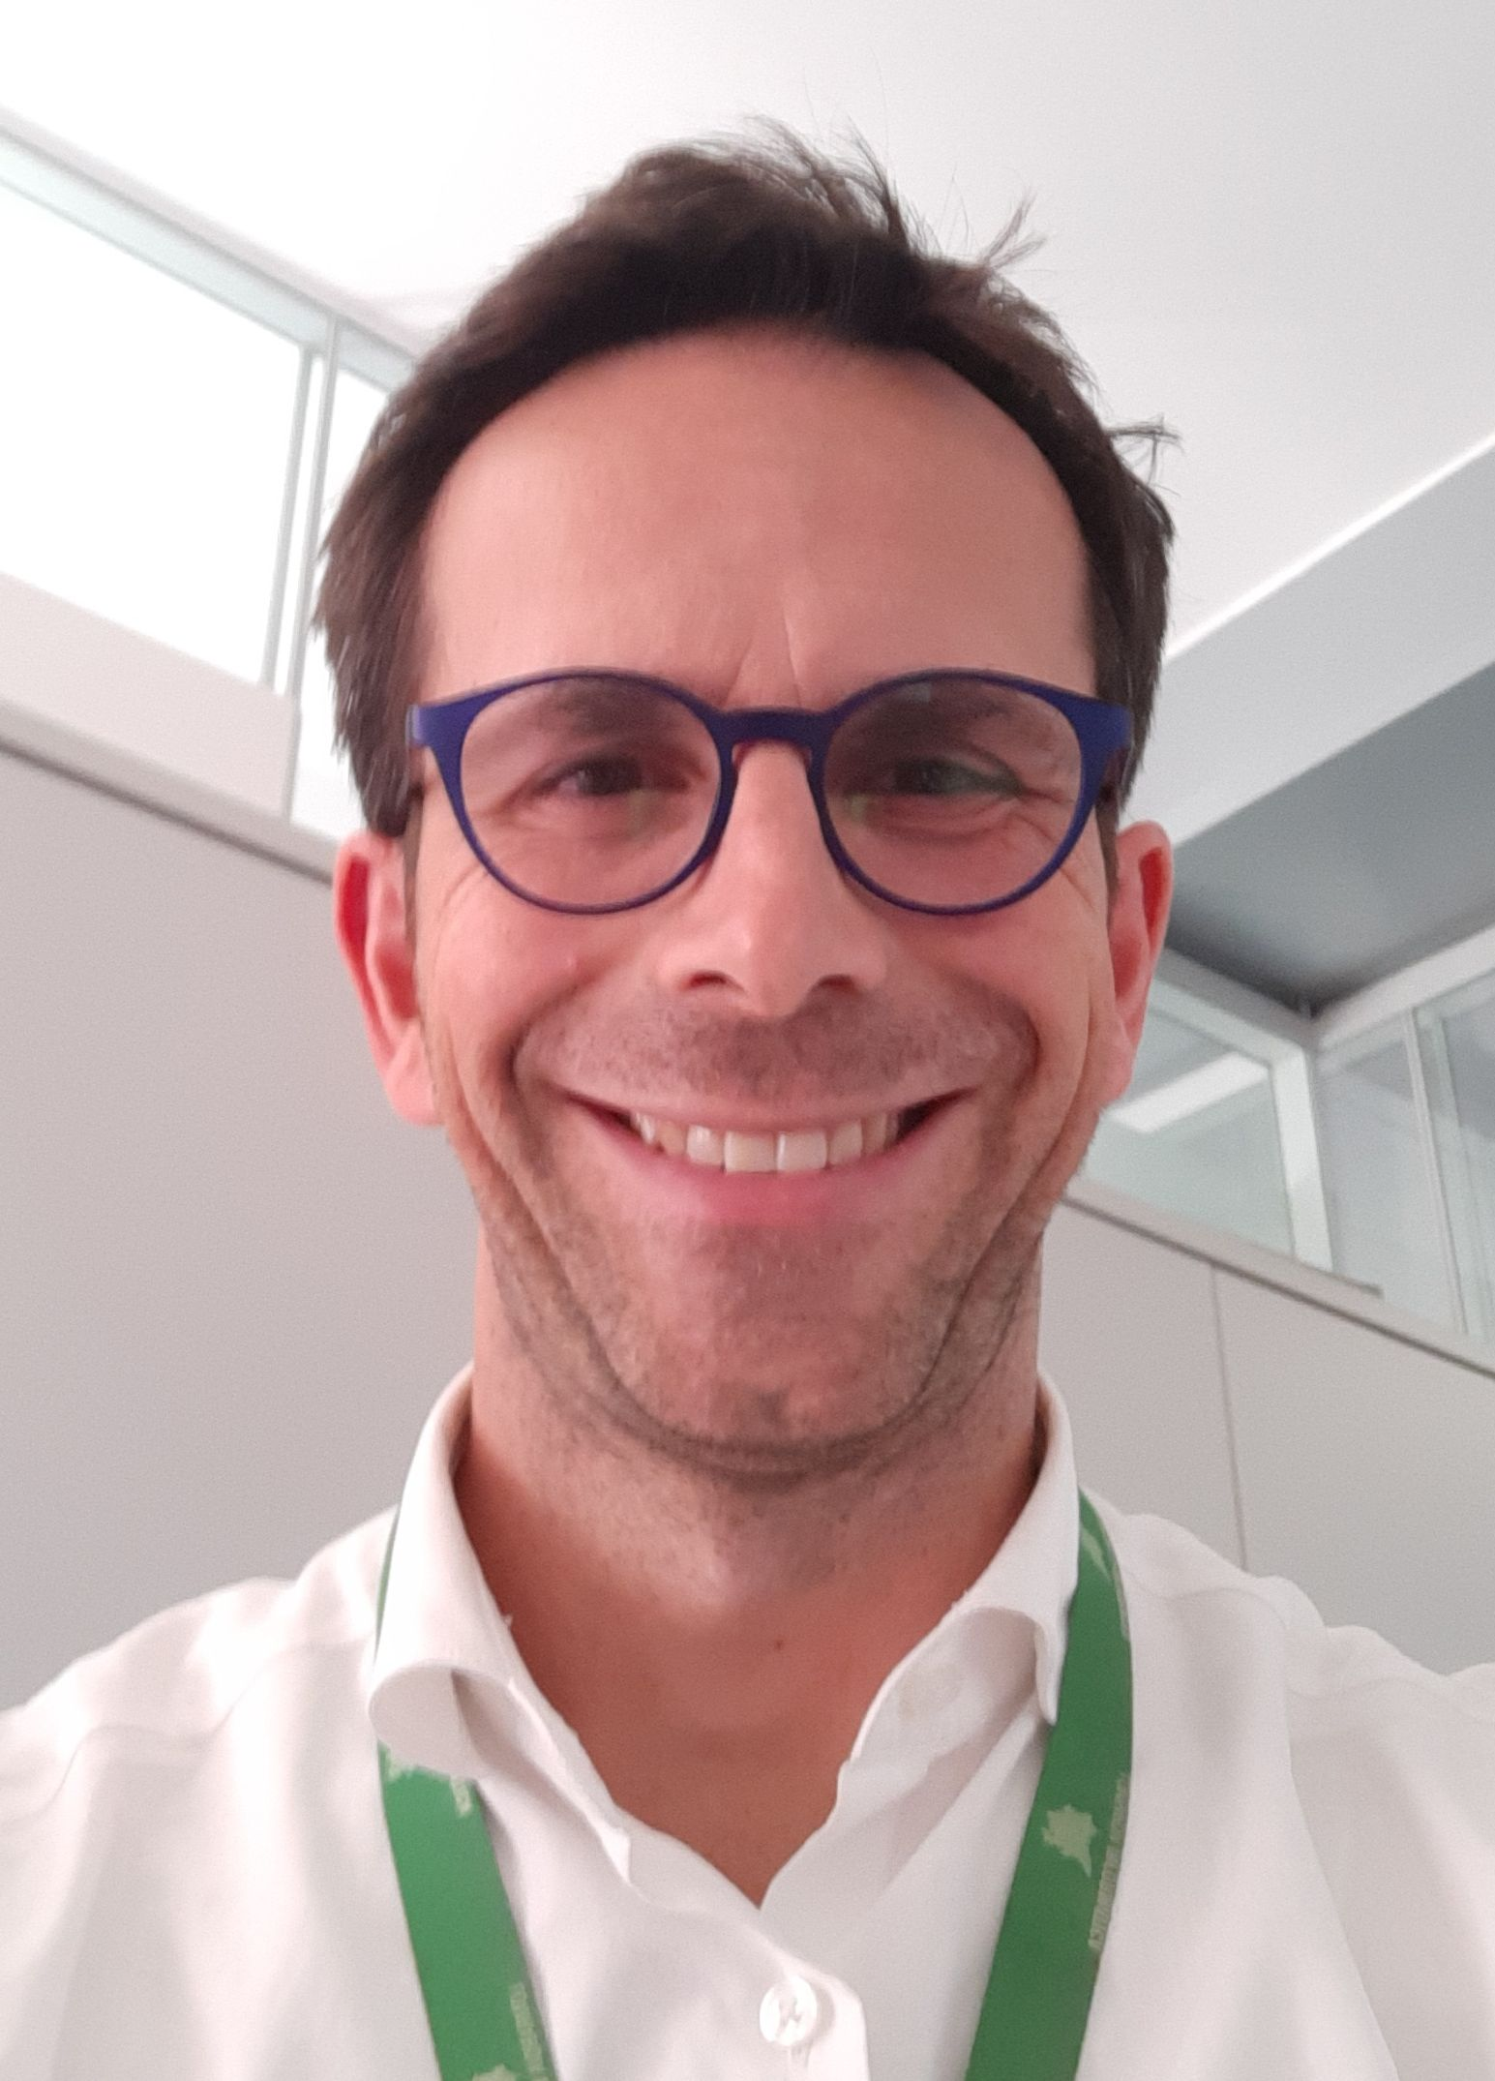
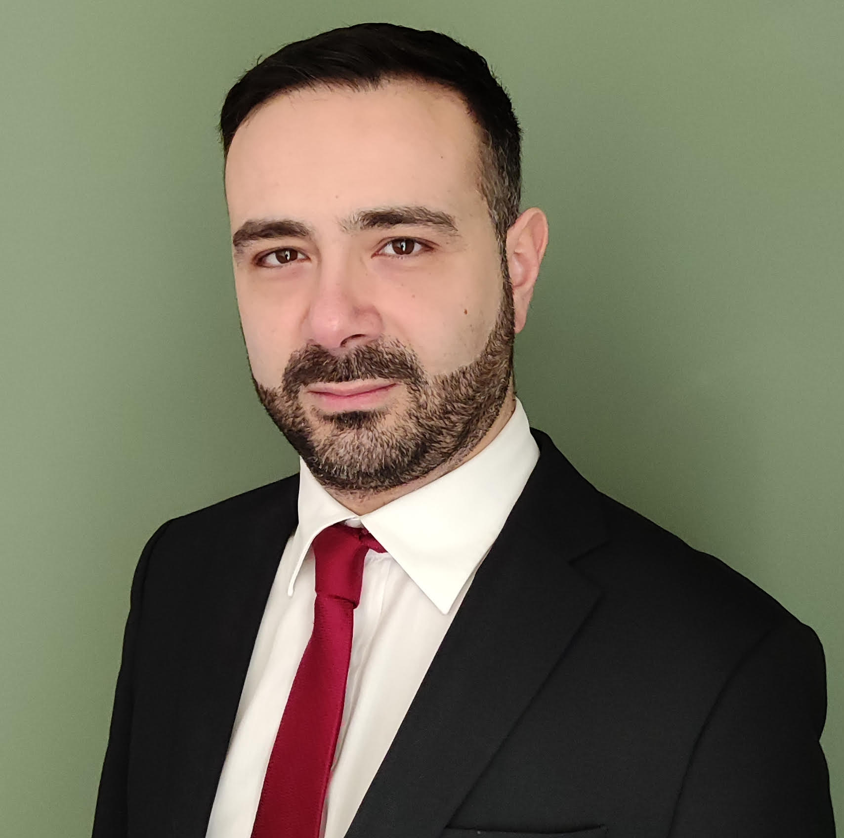
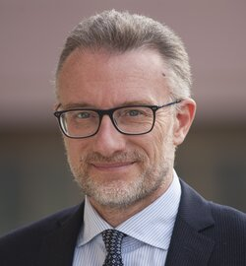
Water Health Open KnoWledge - WHOW
PEOPLE
Azienda regionale per l’Innovazione e gli acquisti
Gianluca Carletti
Project Manager
Giovanni Peditto
Data Architect
Marco Panebianco
Responsible for ARIA
of the Open Data Lombardia programme

Slide 7
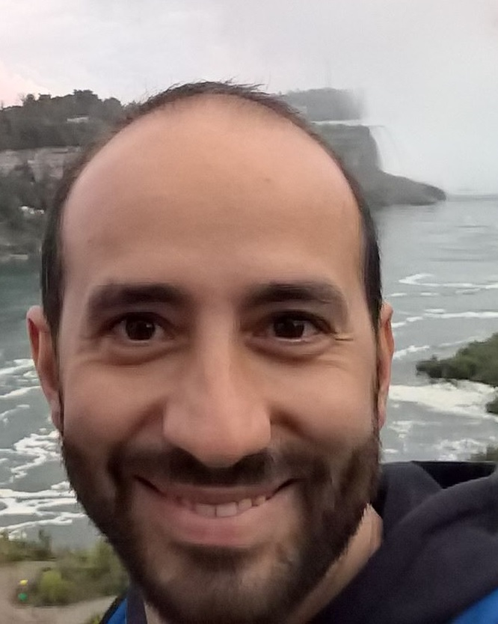
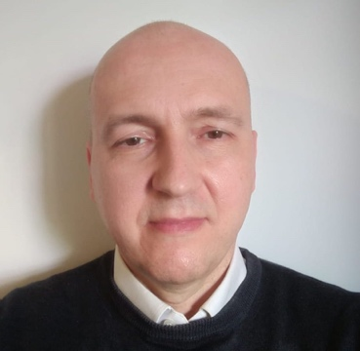
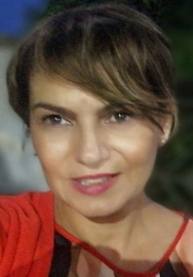
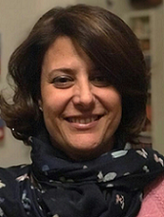
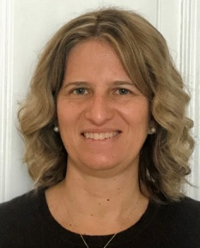
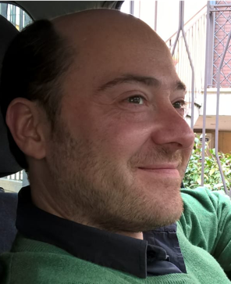
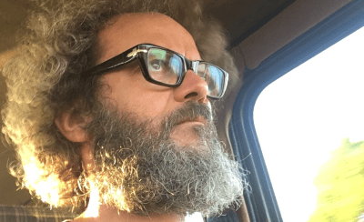
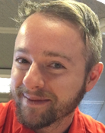
Water Health Open KnoWledge - WHOW
Italian National Institute for Environmental
Protection and Research
Marco
Picone
Project Manager
& Domain expert
Elio
Giulianelli
Linked Open Data Expert
& PM
Alessandra
Casali
Communication & PM support
Patrizia
Borrello
Domain Expert
Emanuela
Spada
Domain Expert
Roberta
De Angelis
Domain Expert
Stefano De Corso
Technical expert for GIS
Davide
Licheri
IT Expert
Andrea
Tosti
IT Expert
Cristian
Di Stefano
IT Expert

Slide 8
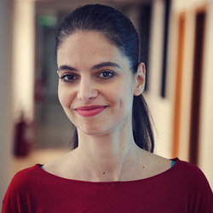
Water Health Open KnoWledge - WHOW
PEOPLE
Italian National Research Council
Semantic Technology Laboratory
Andrea Nuzzolese
Scientific Coordinator
Leader of the technical architecture design and implementation
Giorgia Lodi
Open Data Expert
Project Member supporting the technical architecture design and implementation

Slide 9
Water Health Open KnoWledge - WHOW
TIMELINE
USE CASES and
ARCHITECTURE
Definition of use cases and architecture
IMPACT ASSESSMENT
Consolidated data models.
Implementation of scenarios.
Assessed KPIs and SDGs indicators.
PROJECT START
ONTOLOGIES - BETA VERSION and
DATA PIPELINE
Data pre-processing and LOD pipeline defined. SDGs indicators and KPIs identified.
CO-CREATION PROGRAMME
PROJECT COMPLETION
Knowledge graph developed & ensured
Sustainability.
SEPT 2020
MAY 2021
DEC 2021
MAY 2022
JUNE 2023
AUGUST 2023

Slide 10
Water Health Open KnoWledge - WHOW
GOVERNANCE through CO-CREATION
Co-production
Co-design
Users’ involvement
Co-construction
Scope
*Source: The Lisbon Council

Slide 11
Water Health Open KnoWledge - WHOW
CO-CREATORS
Identify scenarios of interest and datasets.
Support development of products; or applications to enhance data availability.
Contribute to data modelling.
Open data using the same models, and linking them to those of the WHOW partners.
Other
New participants
to be announced

Slide 12
Water Health Open KnoWledge - WHOW
CLUSTER – CEF Public Open Data
INTERSTAT: https://cef-interstat.eu/
ODALA: https://ec.europa.eu/inea/en/connecting-europe-facility/cef-telecom/2019-eu-ia-0098
YODA: https://ec.europa.eu/inea/en/connecting-europe-facility/cef-telecom/2019-es-ia-0121

Slide 13
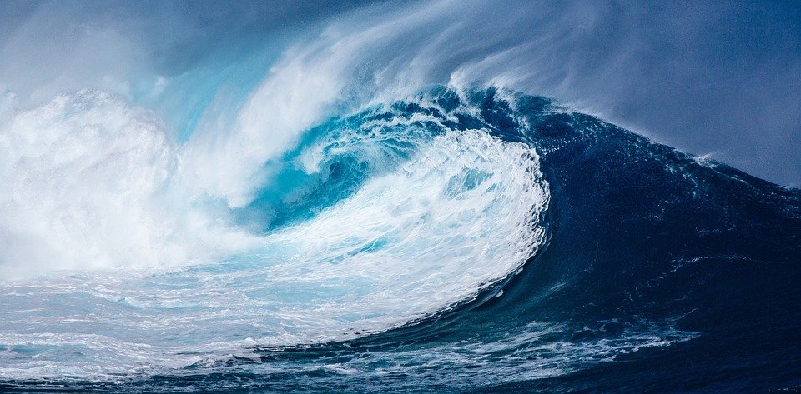
Water Health Open KnoWledge - WHOW
info@whowproject.eu
carmen.ciciriello@celeris-group.eu
www.whowproject.eu
LinkedIn: #whowproject
Twitter: @whowproject

