Slide 1
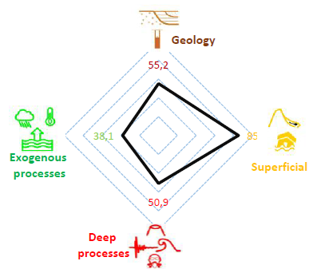
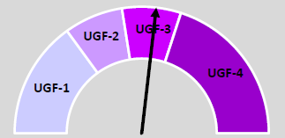
26th of June 11:45 a.m. – 1:00 p.m. CET Central European Time
Ispra and EuroGeoSurveys’ Urban Geology expert Group present the
Free Webinar
How to classify and quickly evaluate the geo-climate issues and hazards of cities?
Discovering the Urban Geo-climate footprint: from the latest release capabilities to the global tool application.
The webinar aims to present a novel methodology called the Urban Geo-climate Footprint (UGF) which has been developed to classify cities quickly and comprehensively from geological and climatic perspectives. The method operates on the fundamental assumption that cities with similar geological-geographical settings will face similar challenges, due to both common geological issues and associated climate impacts.
The UGF approach has been applied to 41 European cities in collaboration with 17 Geological Surveys of Europe.
For those already involved in the project which have tested the tool on their cities, this webinar is interesting for introducing the latest release 9.0 of the tool and its global applicability as well.
Online webinar – UGF Hosted by info@eurogeosurveys.org
https://eurogeosurveys.webex.com/eurogeosurveys/j.php?MTID=me3a965e6da9538b2cf0f94acd3e187dd
Meeting number: 2780 040 3379 Password: ysPnwAa2r28

